Slide 1

By Ravi Pandey
Data Science with Python Career Program - Capstone Project

Slide 2

Agenda
Data Exploration (Using Excel & Python)
Data insights (Excel & Python)
EDA Graphs
Graphical Analysis and conclusion on Data
Data Cleaning & Pre-Processing Steps
ML Modeling
Model Test Evaulation & Prediction Analysis
Deployment of ML Models using Streamlit

Slide 3
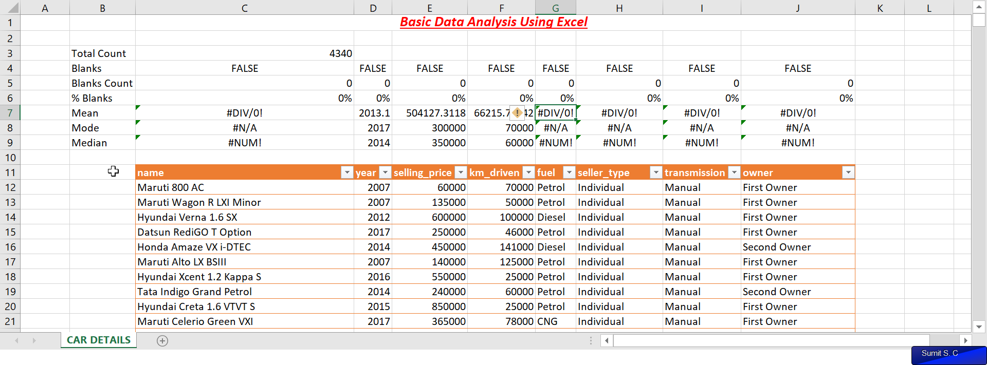
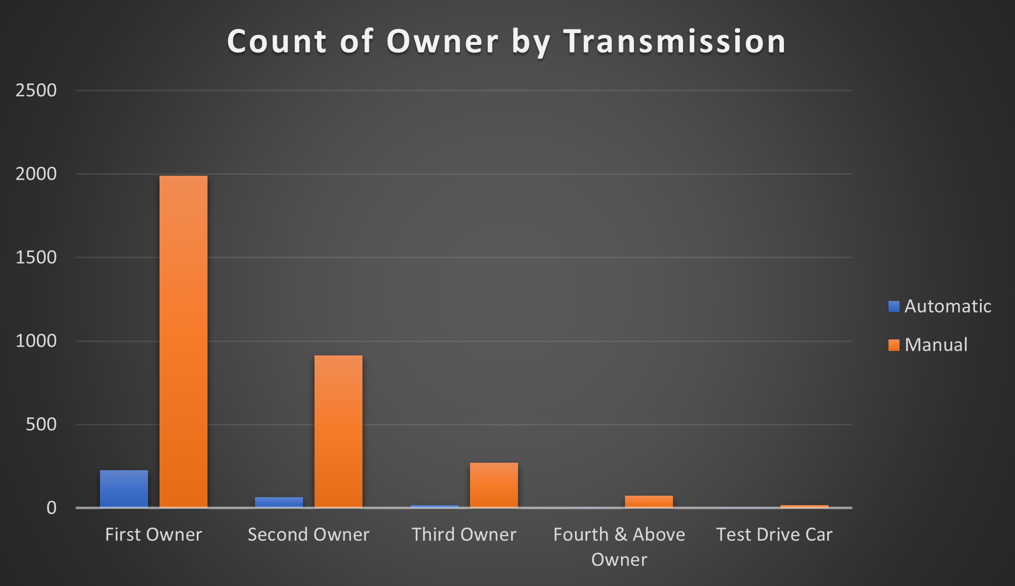
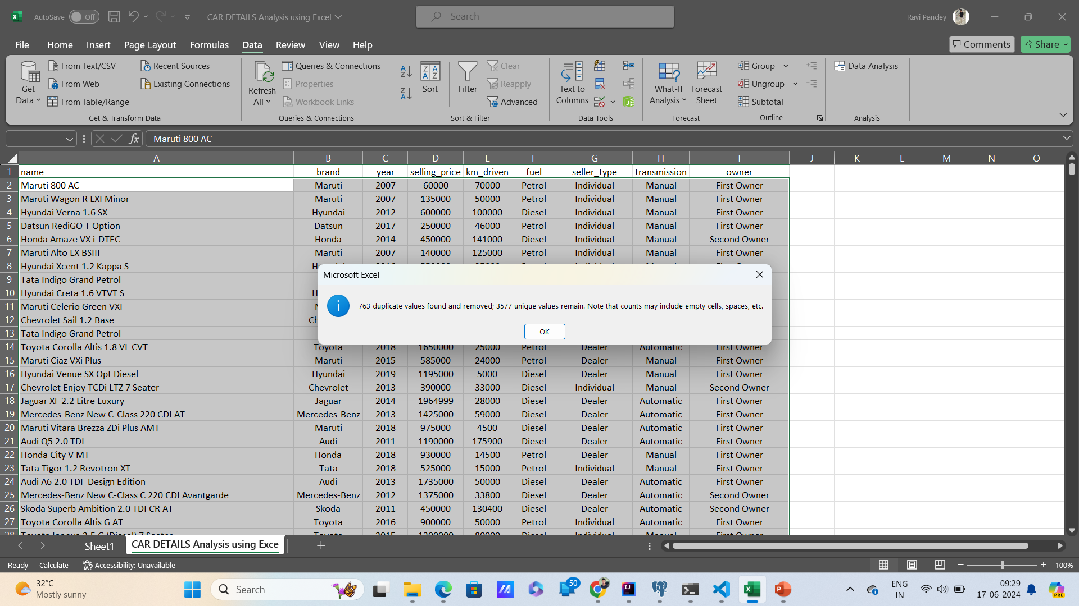
Data Exploration (Using Excel)
Basic Analysis Using Excel Sheet
The Dataset contains 8 rows & 4240 columns showing the information of used cars dataset.
The Basic analysis shows that there is no null value present.
The Analysis further shows that there are 763 duplicate values.
Analyze the count of owners by transmission type, focusing on the first owner who has maximum number of manual cars.

Slide 4
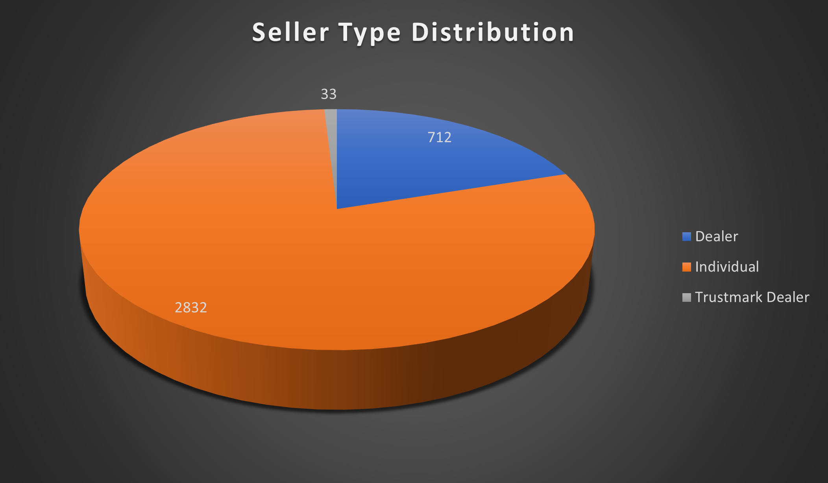
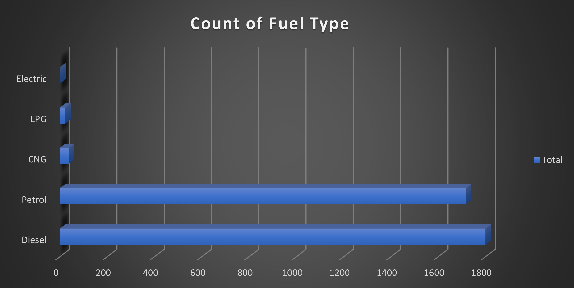
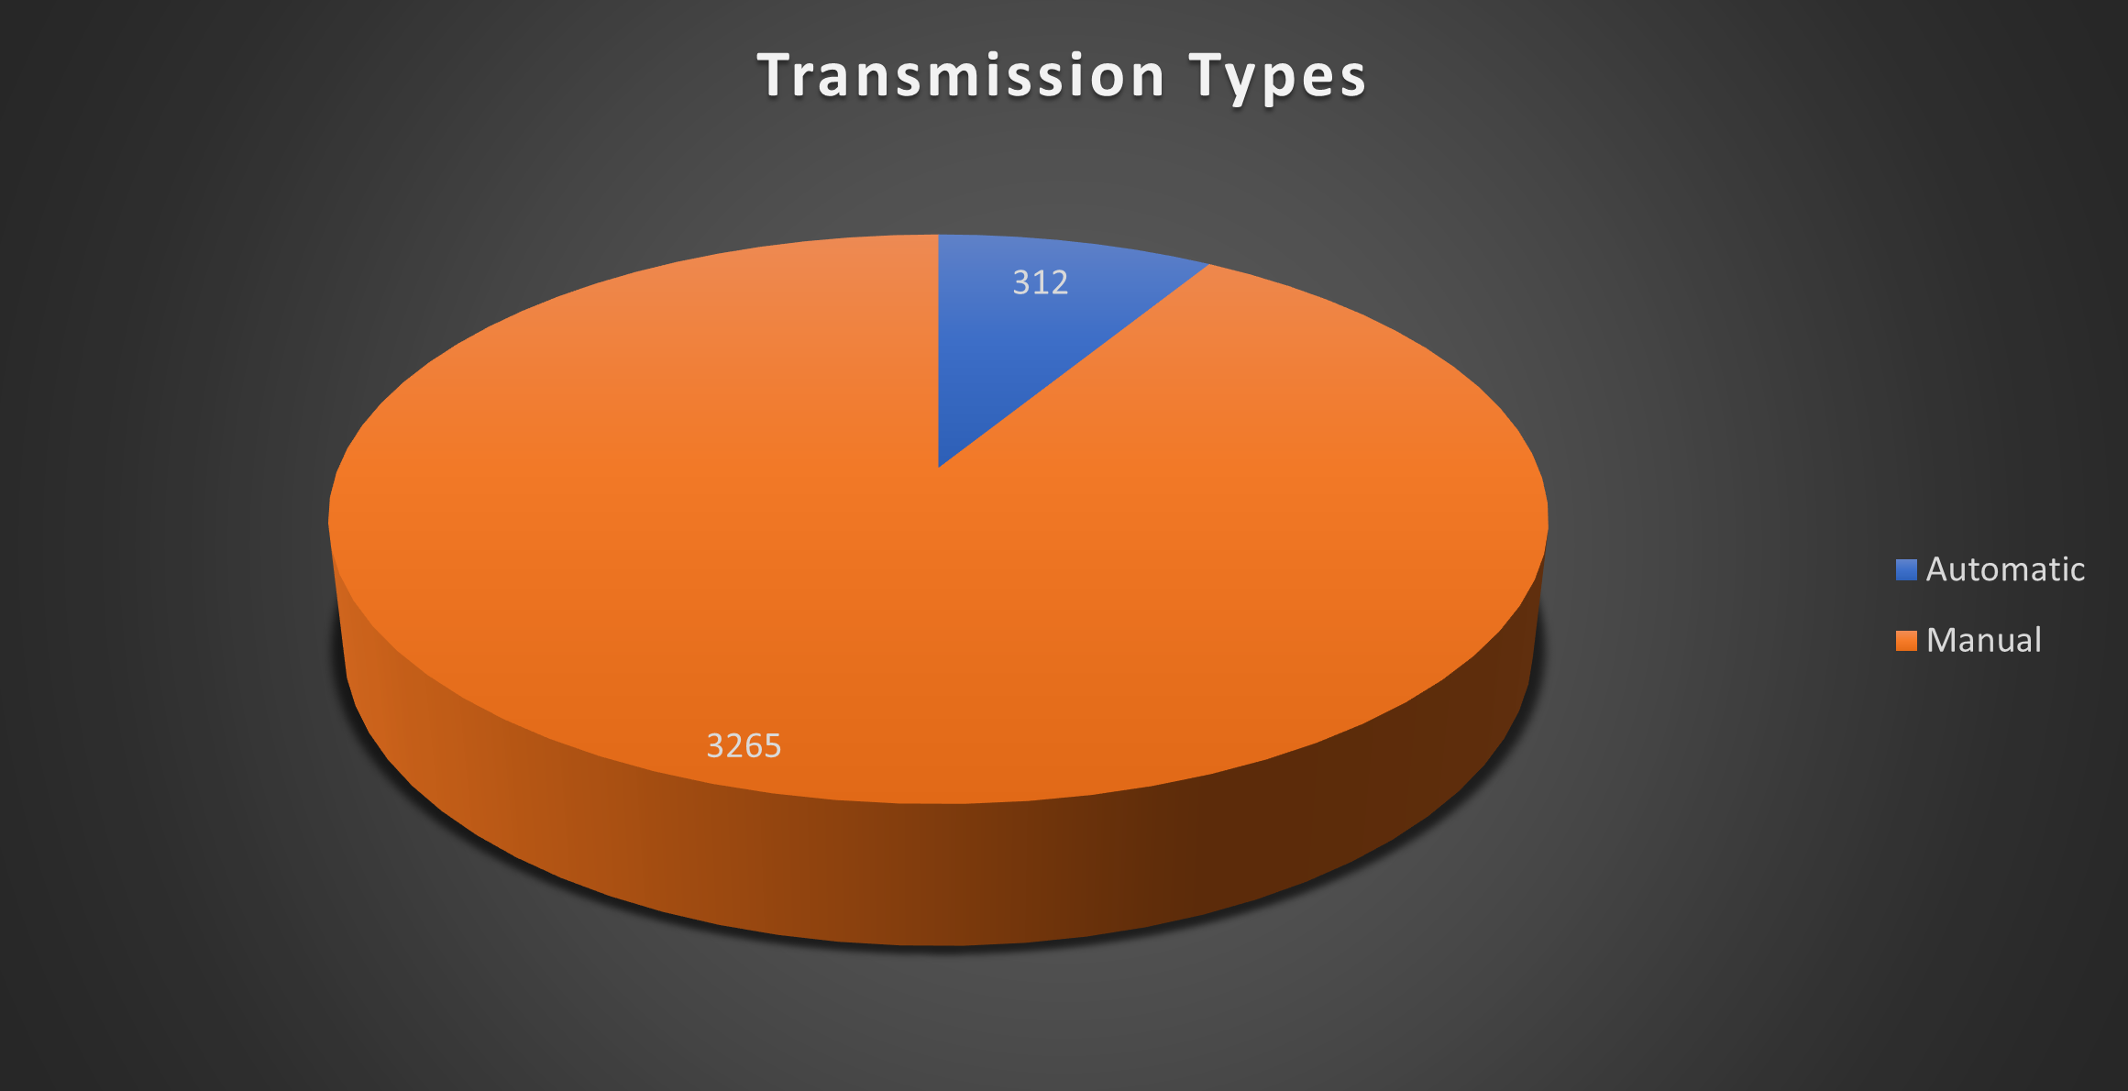
Data Exploration (Using Excel)
These analysis shows distribution of different type of sellers, distribution of transmission and count of fuel types.

Slide 5
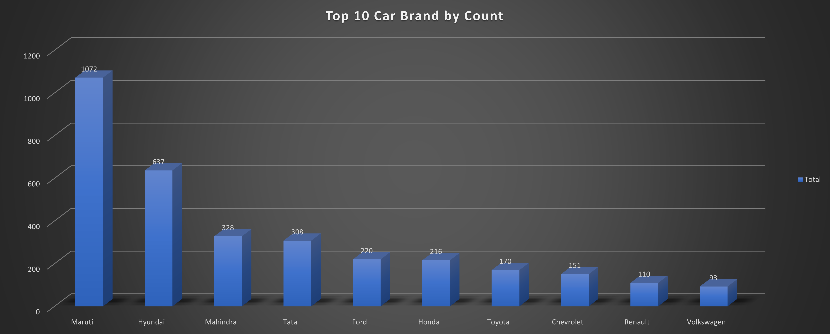
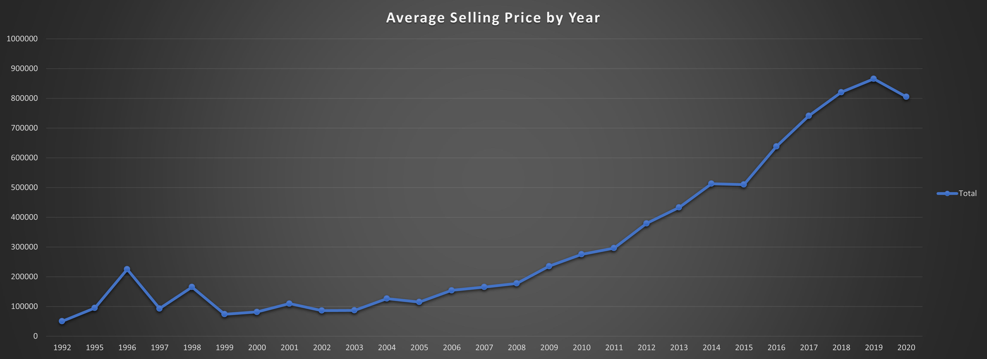
Data Exploration (Using Excel)
Top 10 Car Brands by count.
Maruti and Hyundai are the top most selling cars.
Average selling price distribution by year.
The graph show that the latest model car having higher price.

Slide 6
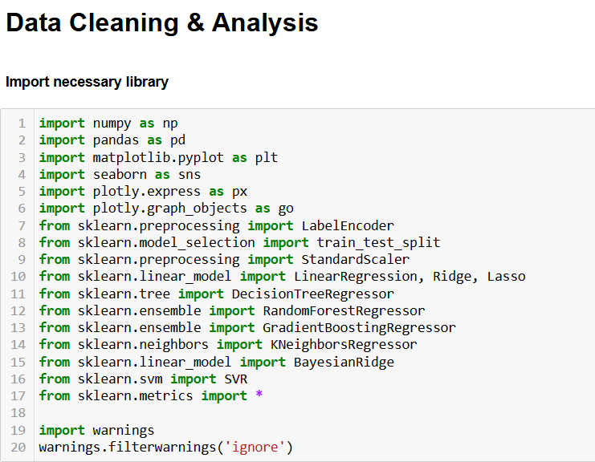
Data Exploration (Using Python)

Slide 7
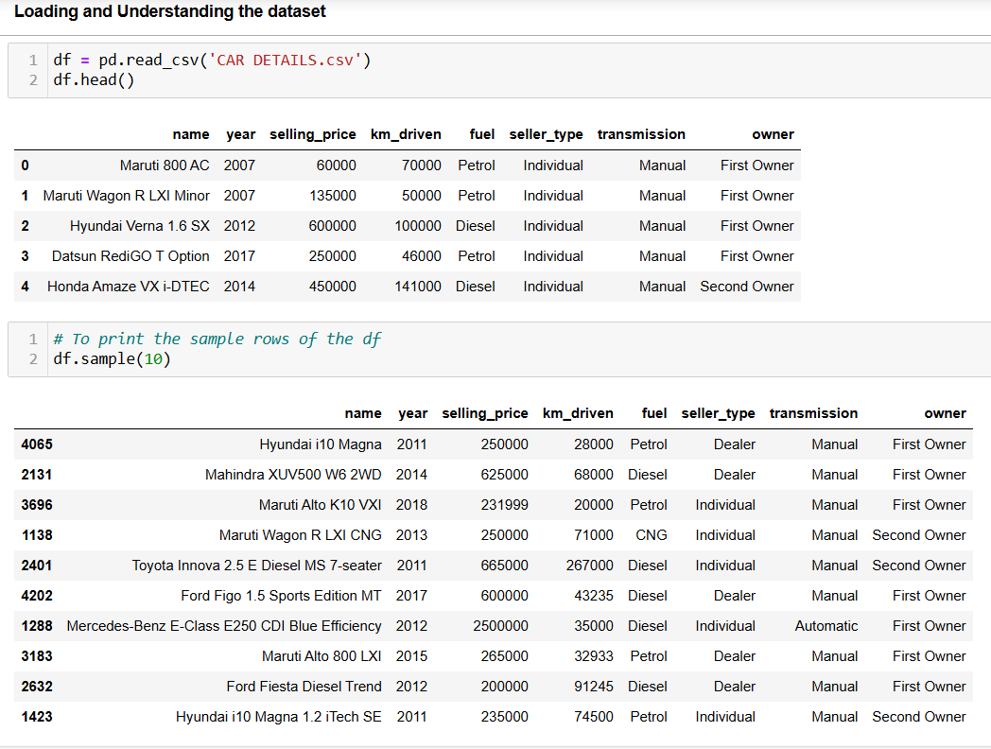
Data Exploration (Using Python)

Slide 8
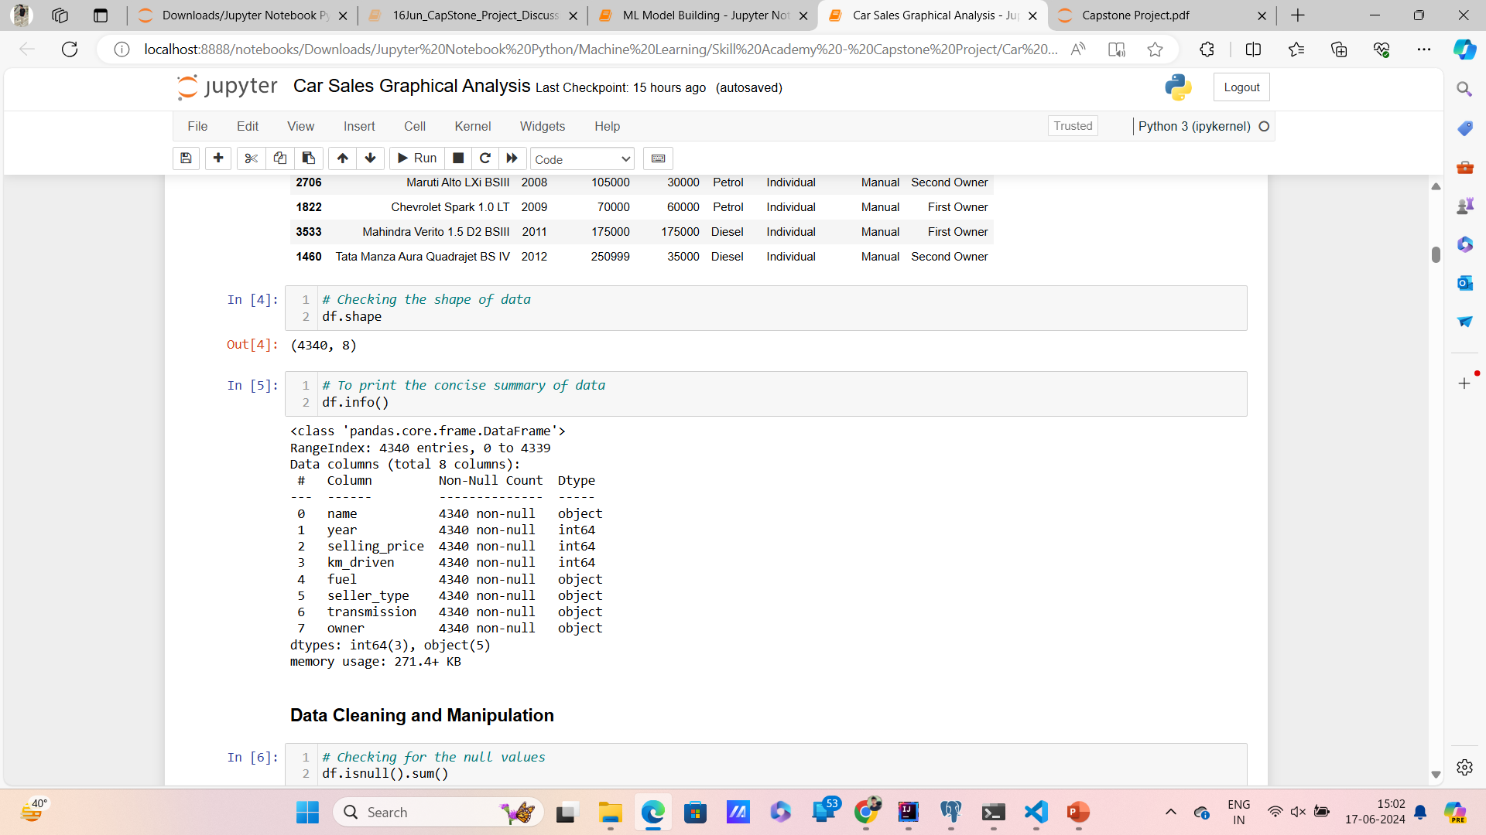
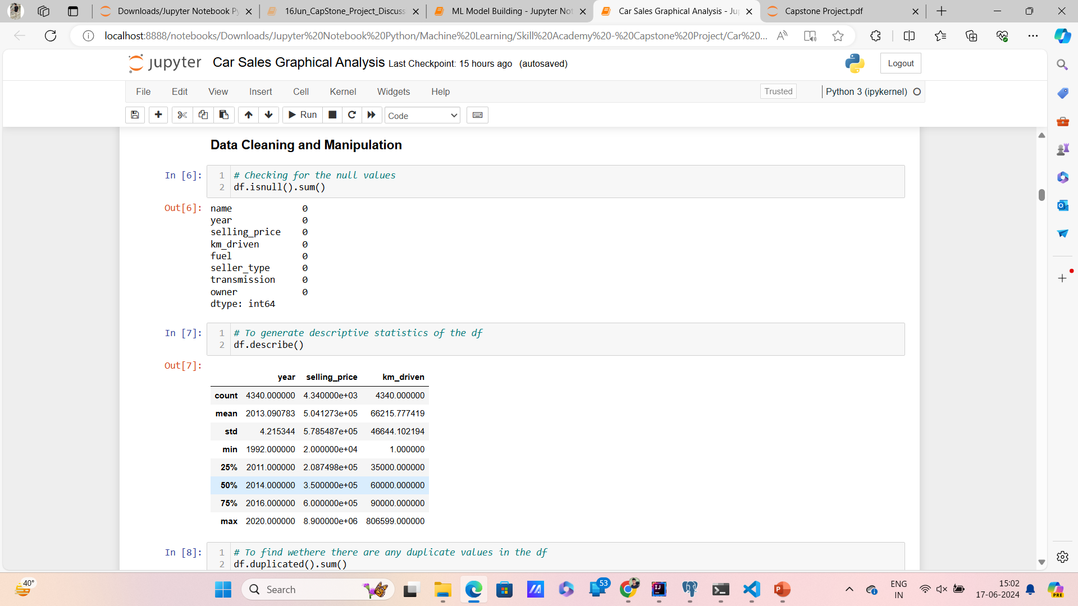
Data Exploration (Using Python)

Slide 9
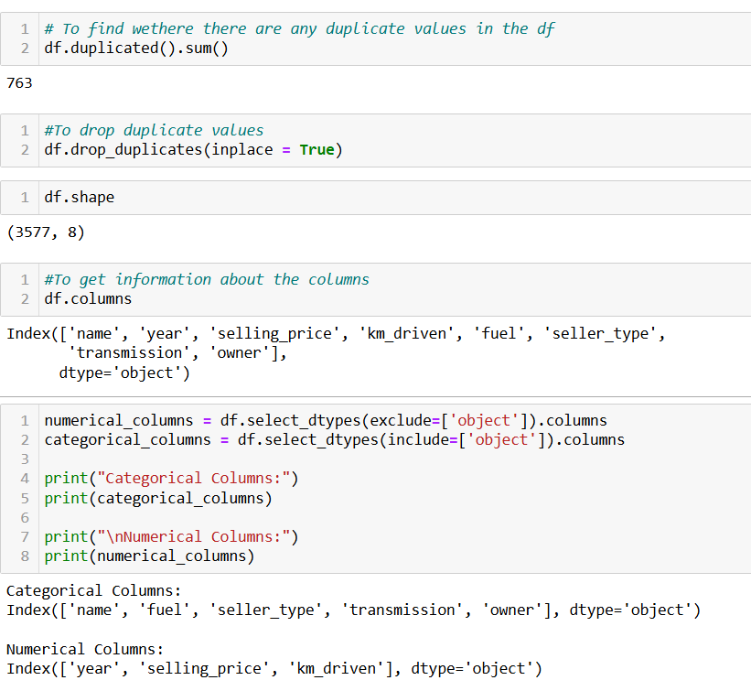
Data Exploration (Using Python)

Slide 10
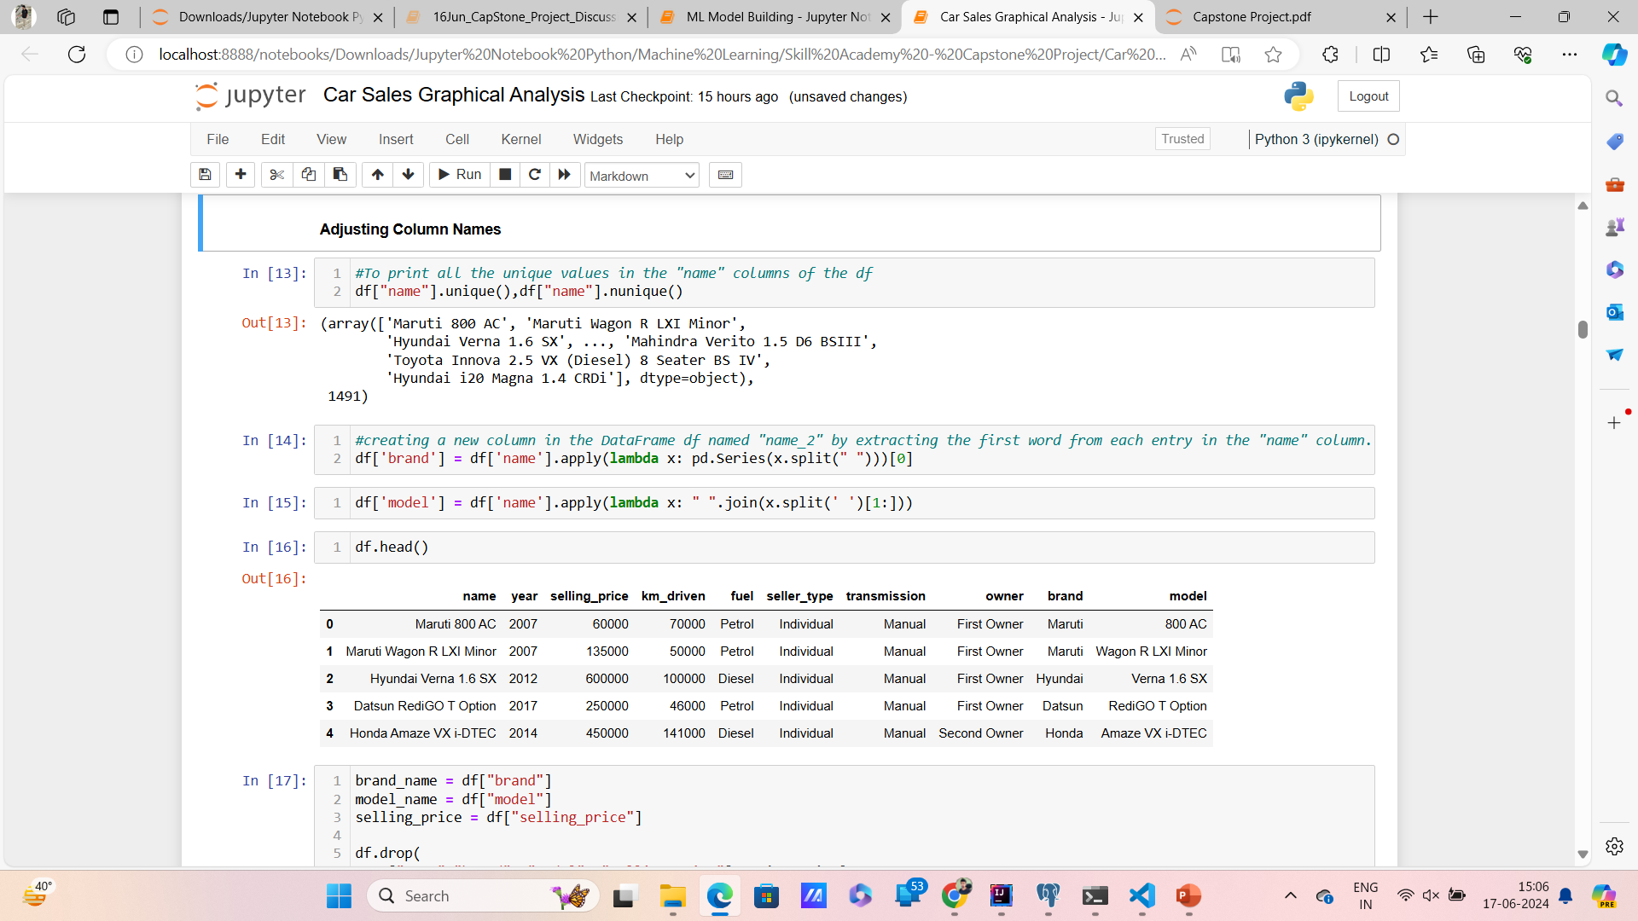
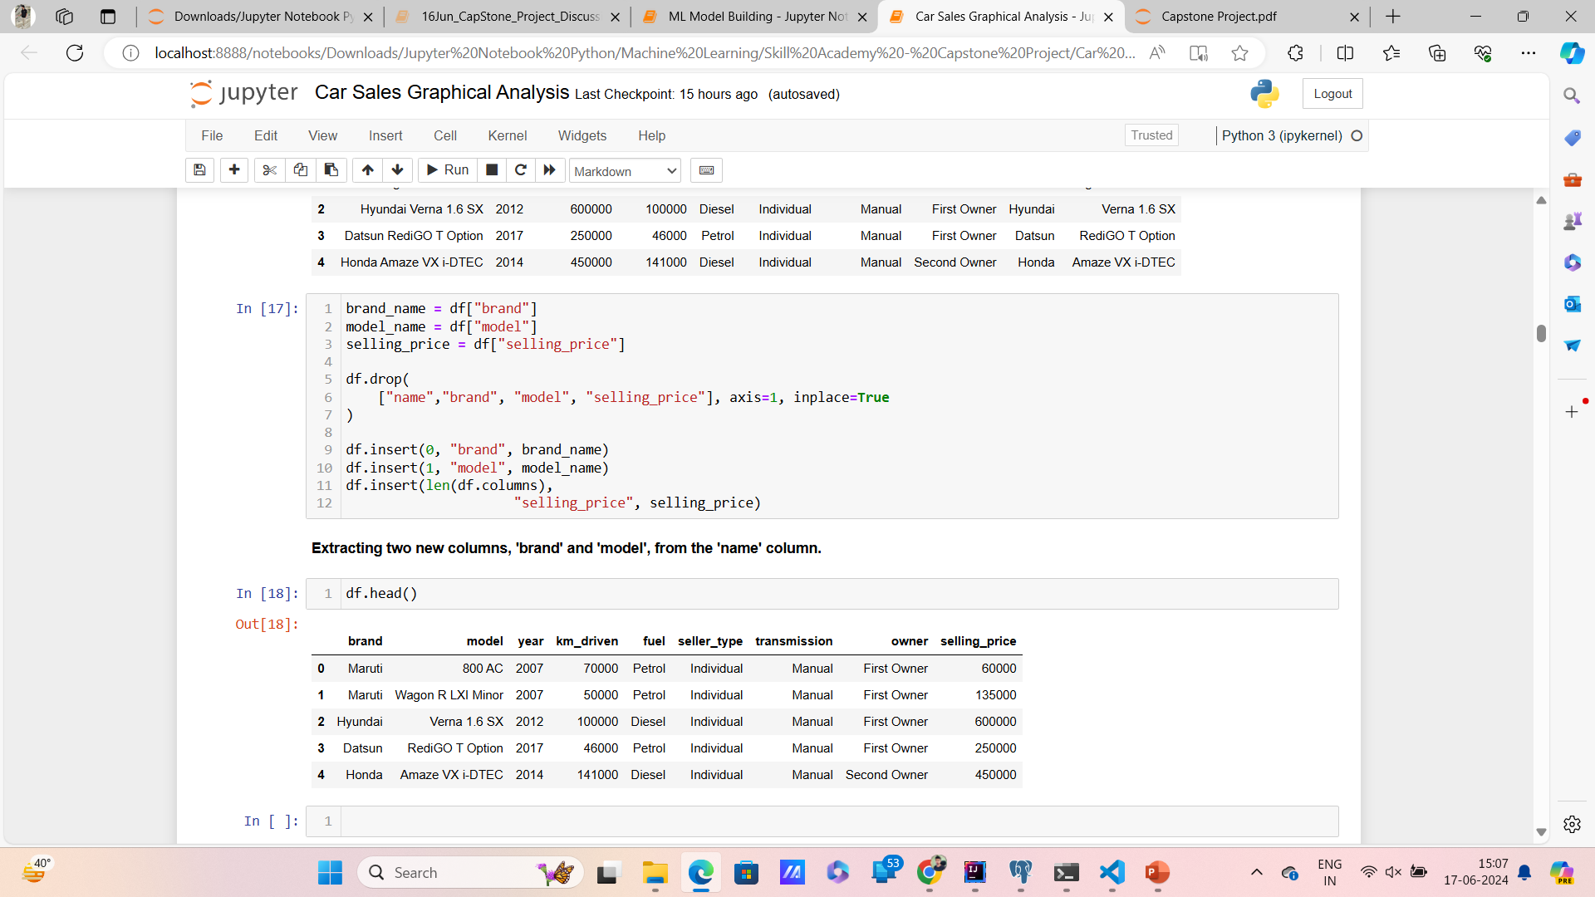
Data Exploration (Using Python)

Slide 11
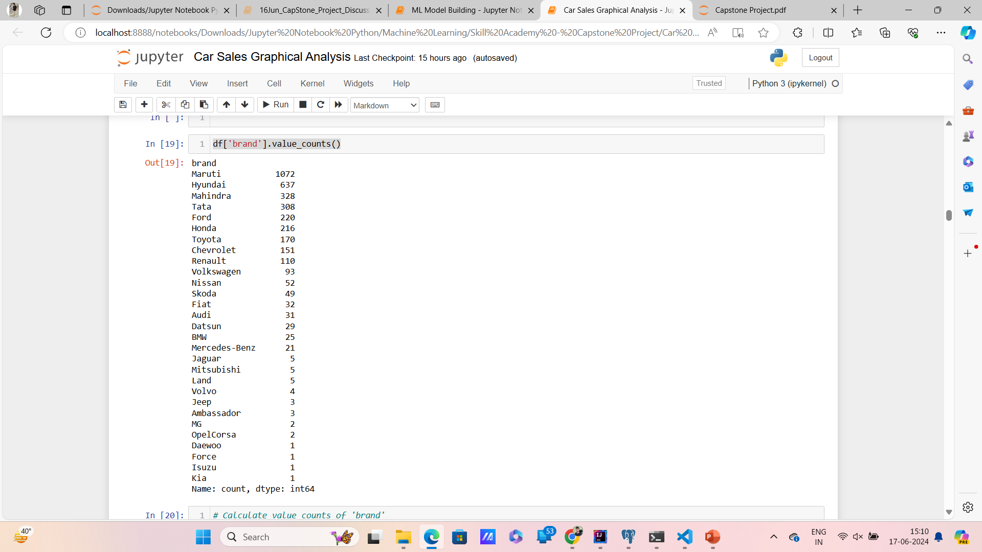
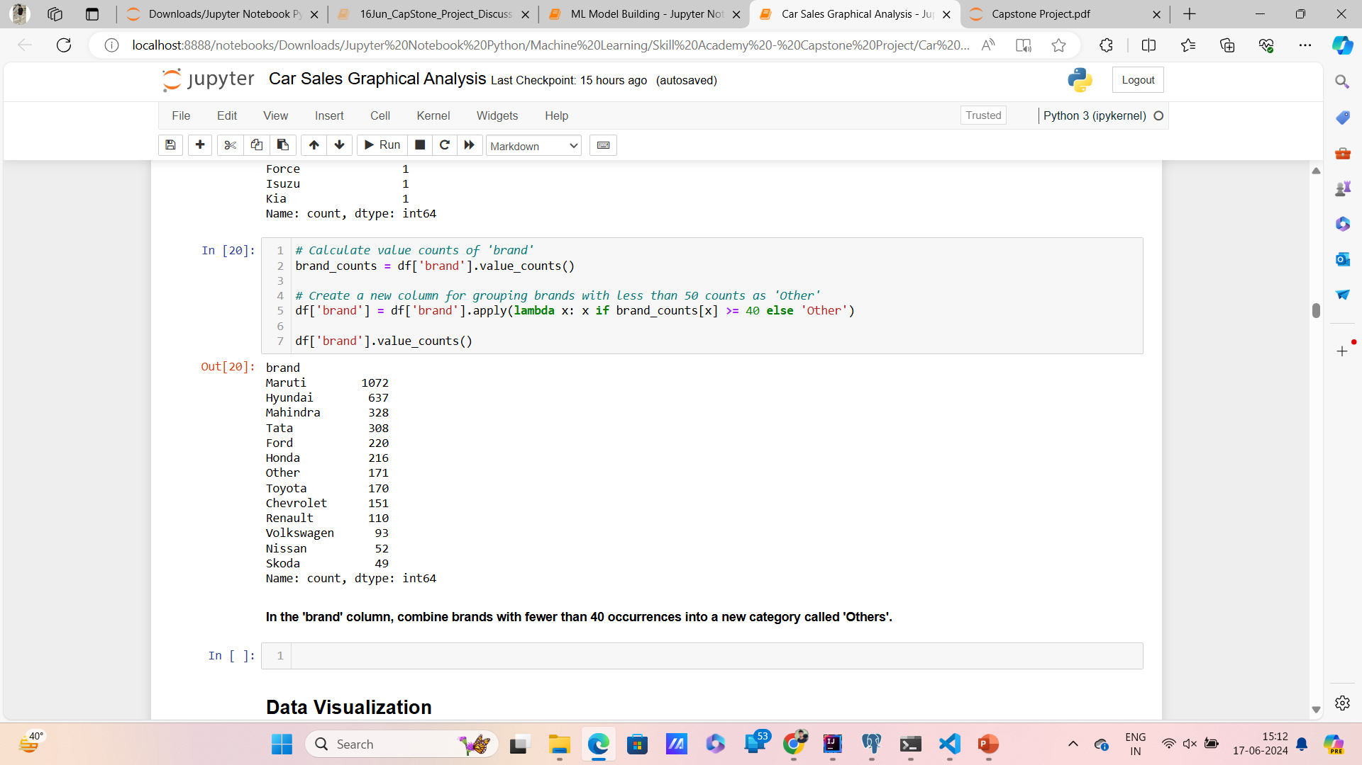
Data Exploration (Using Python)

Slide 12
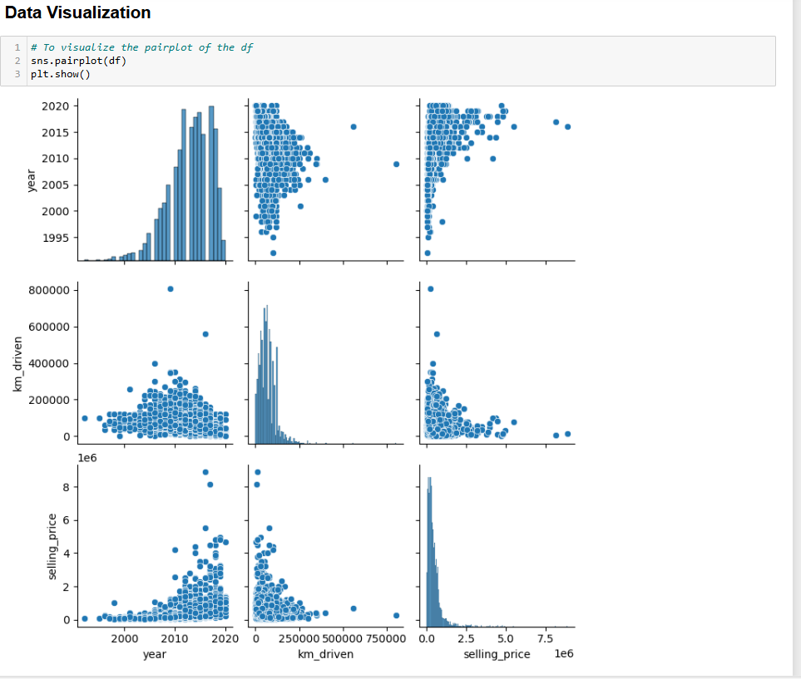
Data Exploration (Using Python)

Slide 13
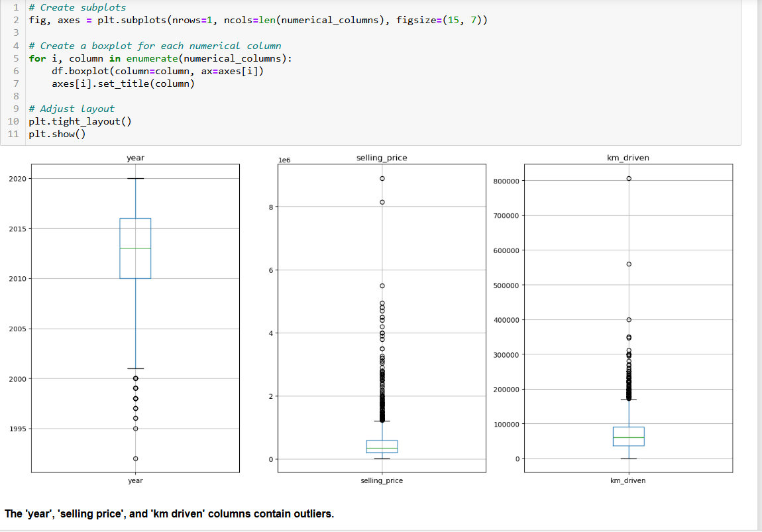
Data Exploration (Using Python)
Boxplot shows that there are outliers in numerical columns. Will handle later

Slide 14
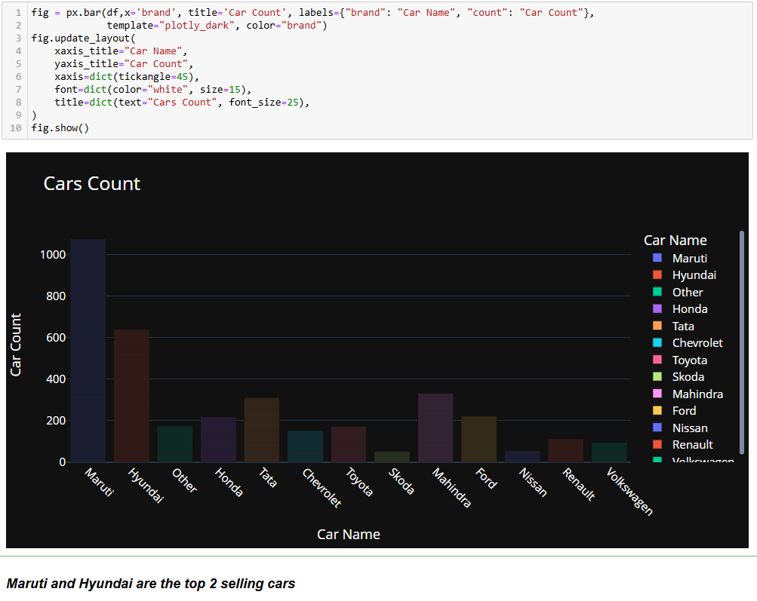
Data Exploration (Using Python)
Maruti Suzuki is the most popular car brand, with almost twice the number of sales compared to the second-place brand, Hyundai.
There is a significant drop in sales between Maruti Suzuki and Hyundai, with the following brands having considerably fewer sales.

Slide 15
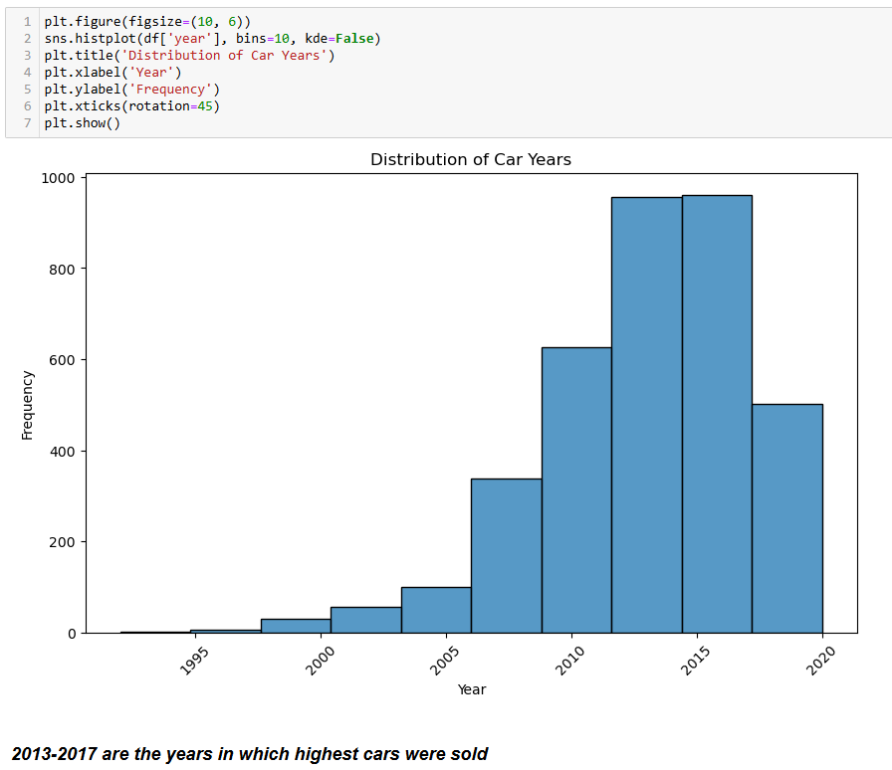
Data Exploration (Using Python)
The most frequent car model year is 2015. There are more cars from 2015 than any other year shown in the data set.
The distribution of car model years is skewed to the right. This means that there are more recent model year cars than older model year cars.
There are a few cars from before 2000. However, the number of cars steadily increases from 2000 to 2015.

Slide 16
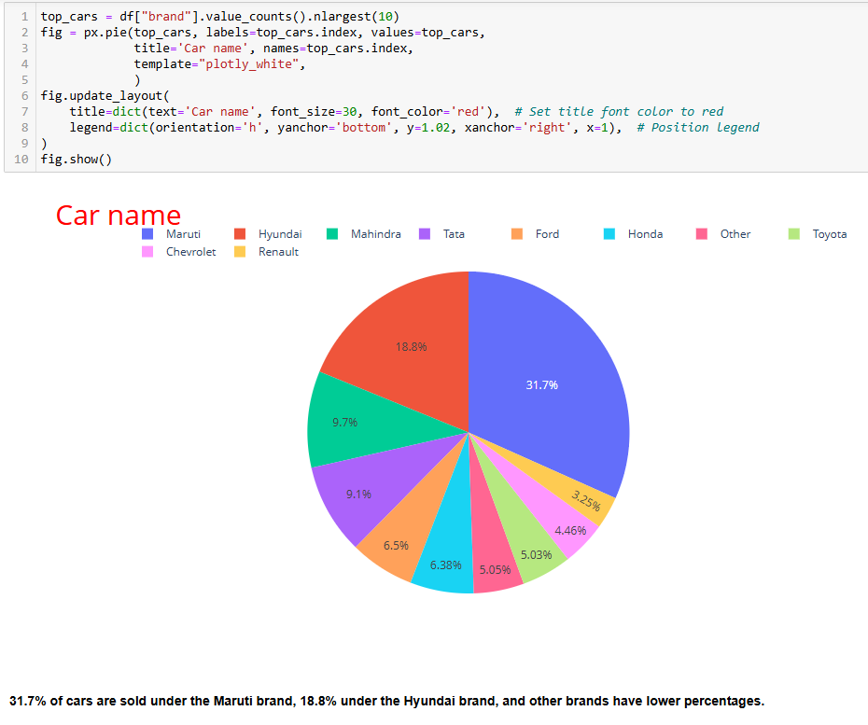
Data Exploration (Using Python)
The pie chart shows the distribution of car sales for different car brands. The largest slice of the pie chart is Maruti, at 31.7%. This suggests that Maruti is the most popular car brand out of the ones listed. Other large slices of the pie chart include Hyundai (19.3%) and Mahindra (10.3%). Brands such as Renault and Chevrolet have a much smaller slice of the pie chart (1.2% and 0.9% respectively).
Here are some other insights you can draw from the pie chart:
The top 5 car brands (Maruti, Hyundai, Mahindra, Tata, and Toyota) account for over 63% of the car sales.
There are a significant number of other car brands that are not listed in the chart but that collectively account for 13.8% of the sales.
Overall, the pie chart suggests that the car sales market is dominated by a few major brands.

Slide 17
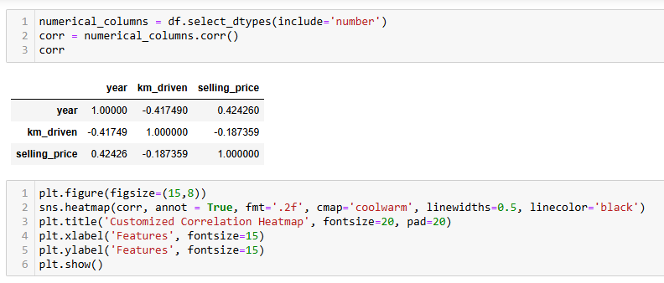
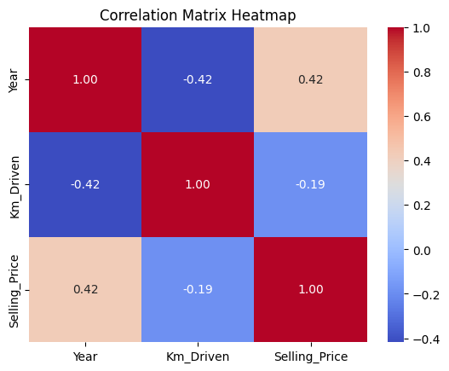
Data Exploration (Using Python)
The correlation matrix heatmap you sent shows that there is a negative correlation between the selling price of a car and the number of kilometers driven (Km_Driven). A negative correlation means that two variables move in opposite directions. In this case, as the number of kilometers driven increases, the selling price of the car decreases. This makes sense because cars with higher mileage are typically less valuable than cars with lower mileage.
Here are some other factors that may influence the selling price of a car:
Make and model: Different makes and models of cars depreciate at different rates.
Age of the car: As a car gets older, it is typically worth less.
Overall condition of the car: Cars that are in good condition will typically sell for more than cars that are in poor condition
Features: Cars with more features will typically sell for more than cars with fewer features.

Slide 18
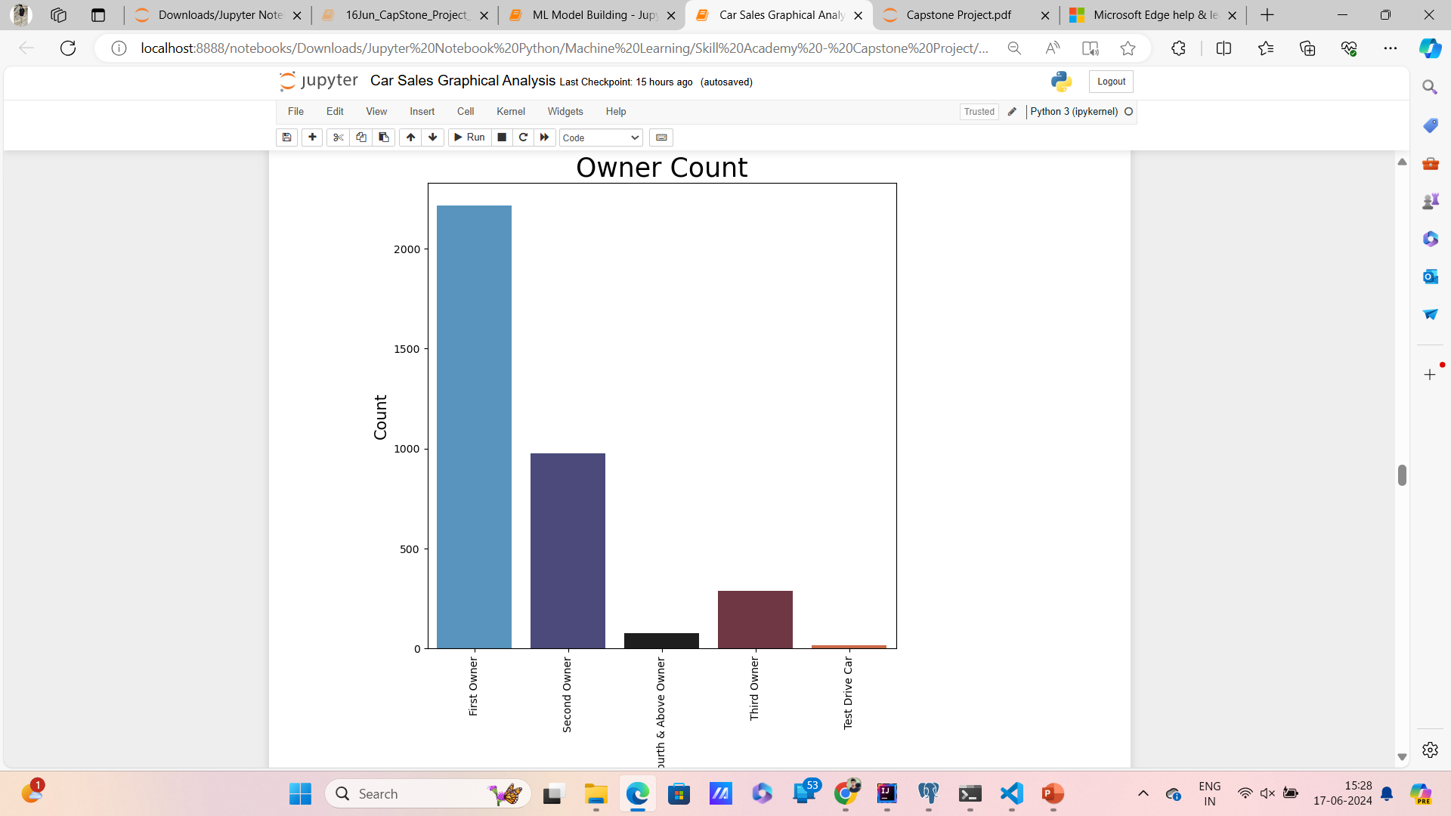
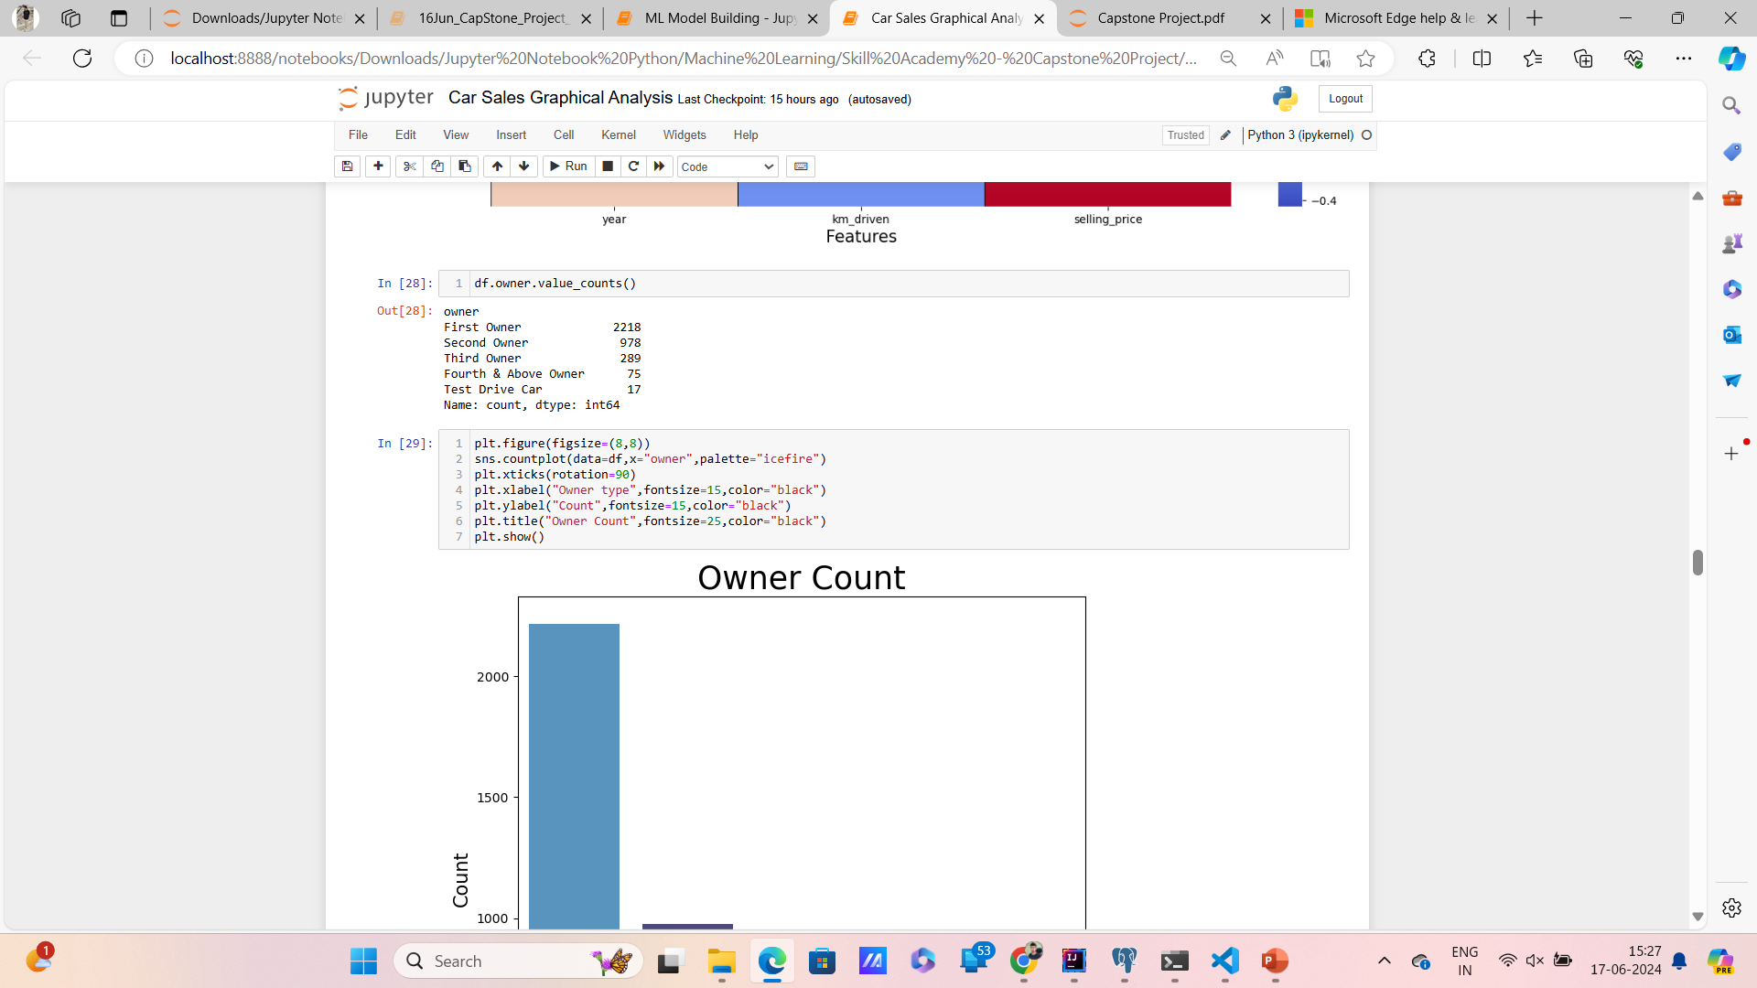
Data Exploration (Using Python)
Overall, the countplot suggests that most of the cars in the dataset have had only one or zero owners.
Overall, the countplot suggests that most of the cars in the dataset have had only one or zero owners.pen_spark

Slide 19
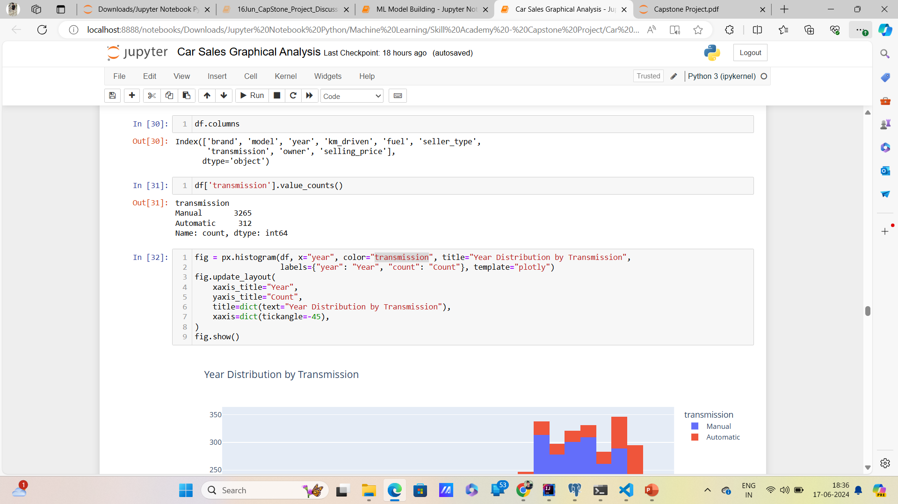
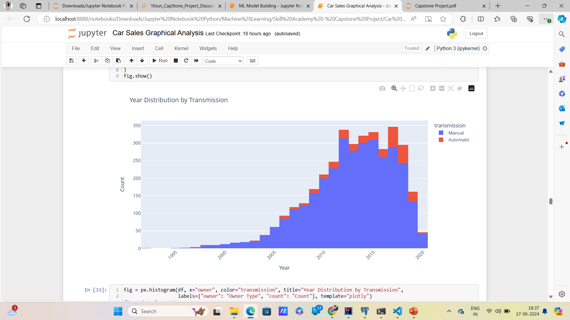
Data Exploration (Using Python)

Slide 20
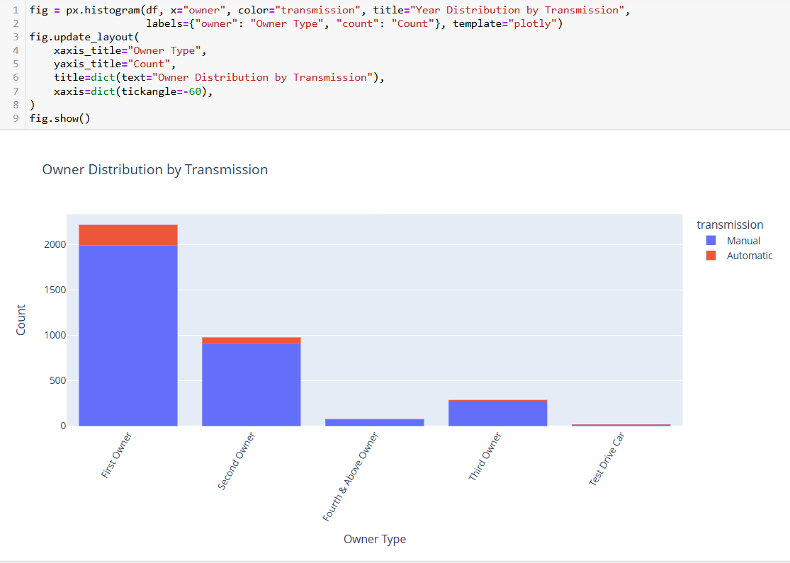
Data Exploration (Using Python)
There are 227 first-owner vehicles with automatic transmissions.
There are 1,991 first-owner vehicles with manual transmissions.
Among second-owner vehicles:
64 have automatic transmissions.
914 have manual transmissions.
Among third-owner vehicles:
2 have automatic transmissions.
271 have manual transmissions.
Test drive cars are negligible in number.

Slide 21
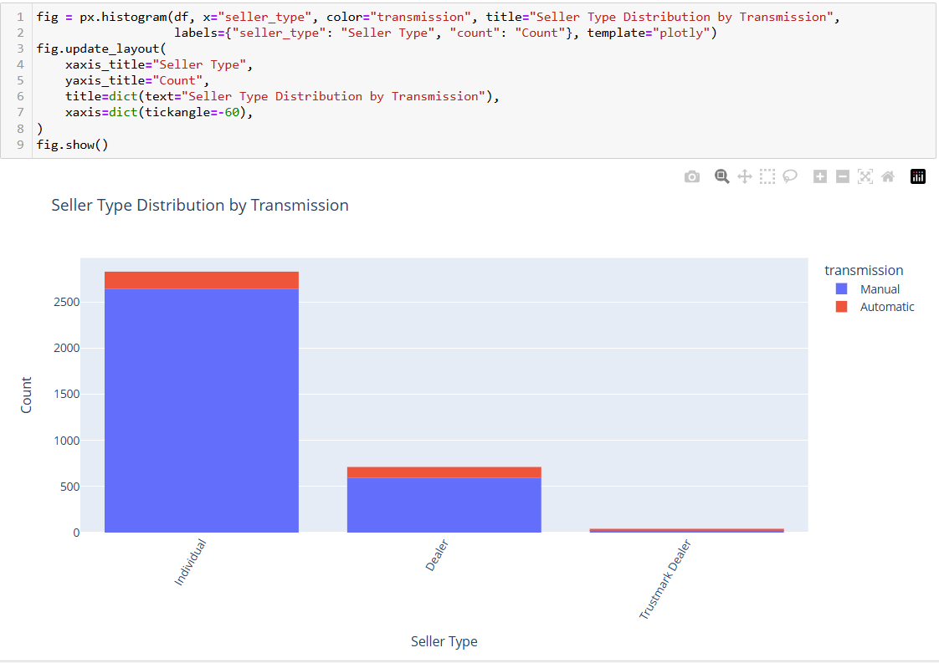
Data Exploration (Using Python)
A total of 2,832 cars were purchased directly by individuals, comprising 2,646 manual and 186 automatic vehicles.
A total of 712 cars were purchased by individuals through dealers, comprising 593 manual and 119 automatic vehicles.
A total of 33 cars were purchased by individuals through trustmark dealers, comprising 26 manual and 7 automatic vehicles.

Slide 22
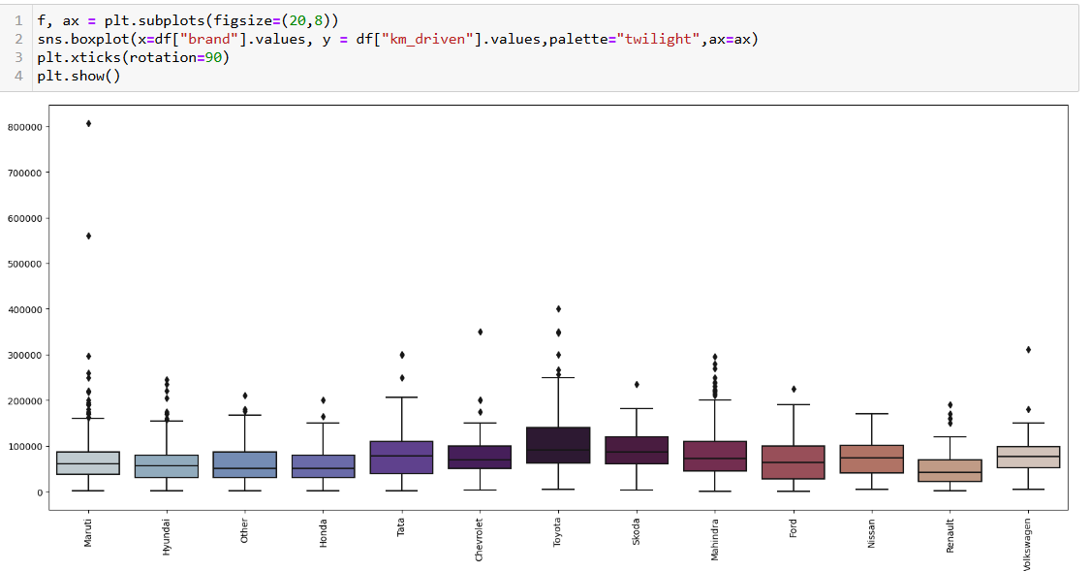
Data Exploration (Using Python)

Slide 23
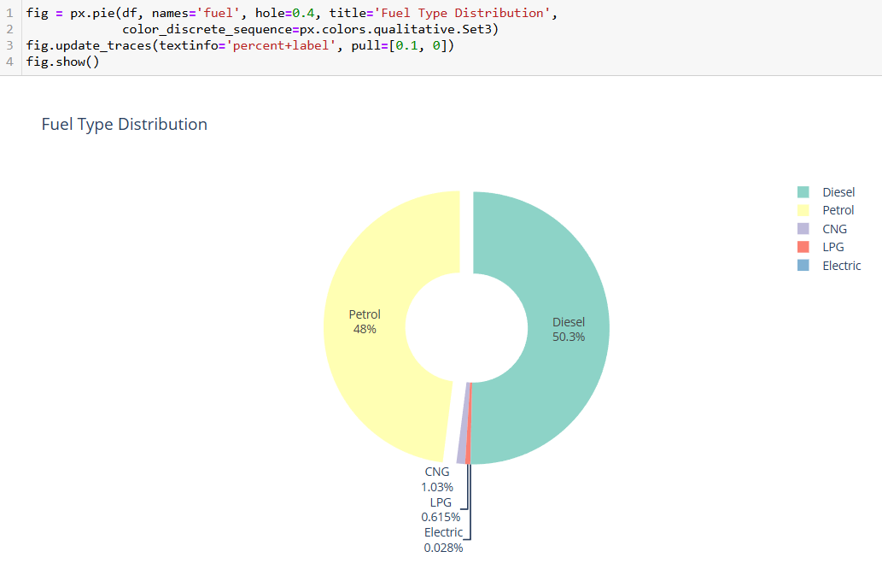
Data Exploration (Using Python)
50.3% of vehicles are diesel vehicles.
48% of vehicles are petrol vehicles.
The remaining vehicles are classified under other categories.

Slide 24
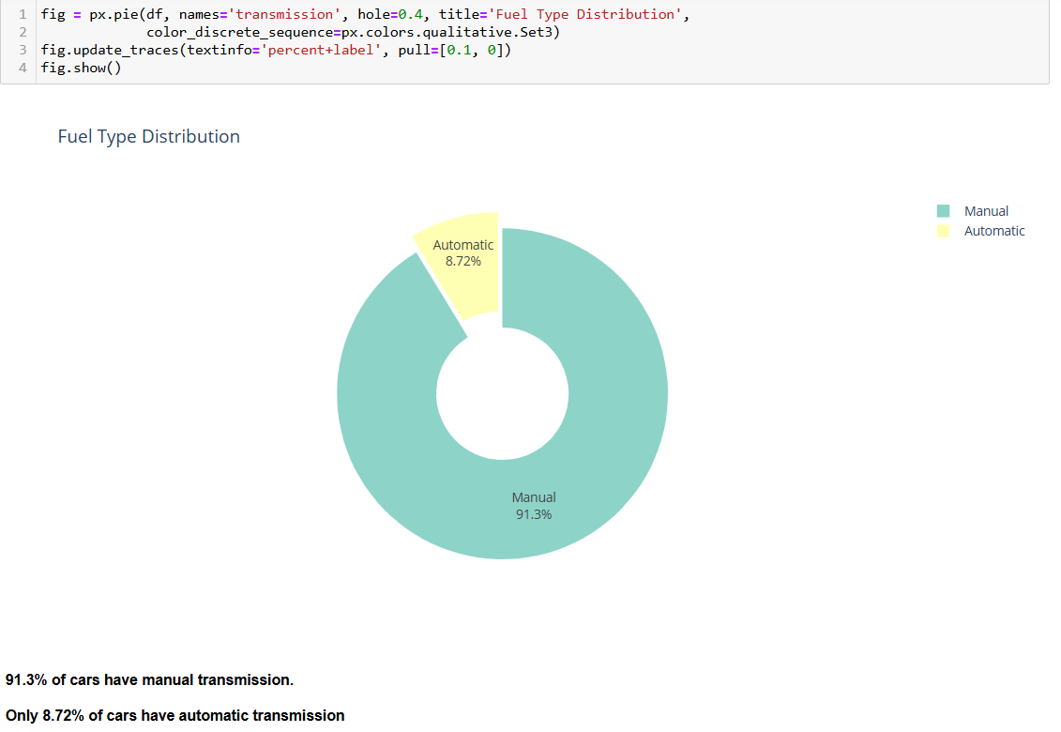
Data Exploration (Using Python)

Slide 25
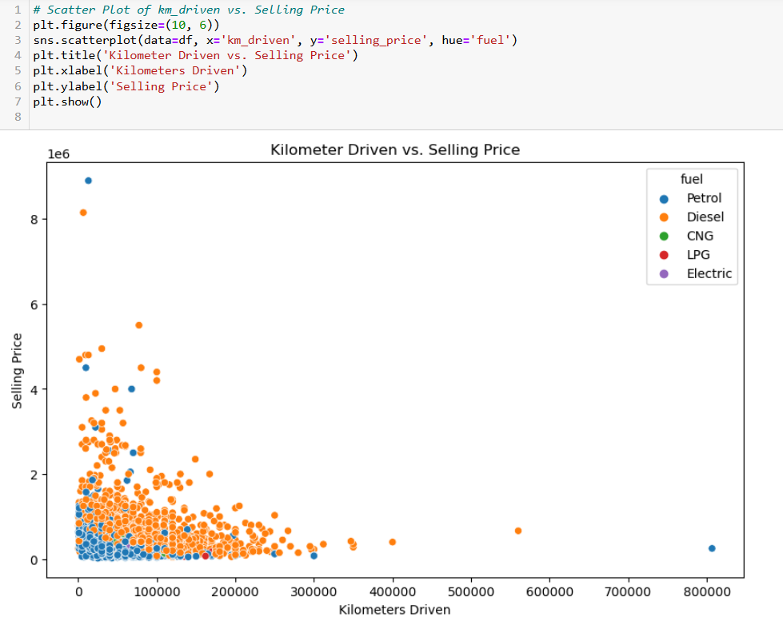
Data Exploration (Using Python)
There is a negative correlation between Kilometer Driven and selling price: As the mileage driven increases, the selling price tends to decrease. This suggests that cars with higher mileage tend to sell for lower prices.

Slide 26
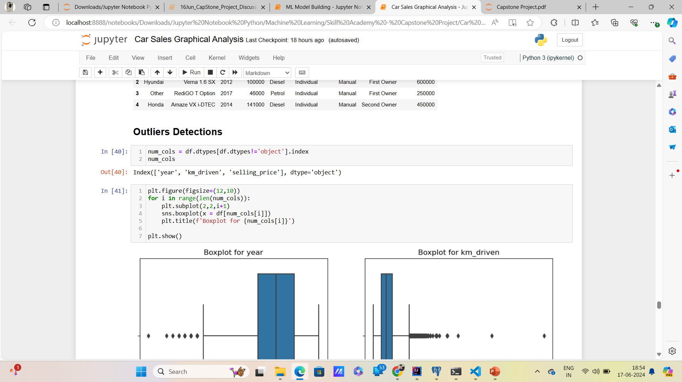
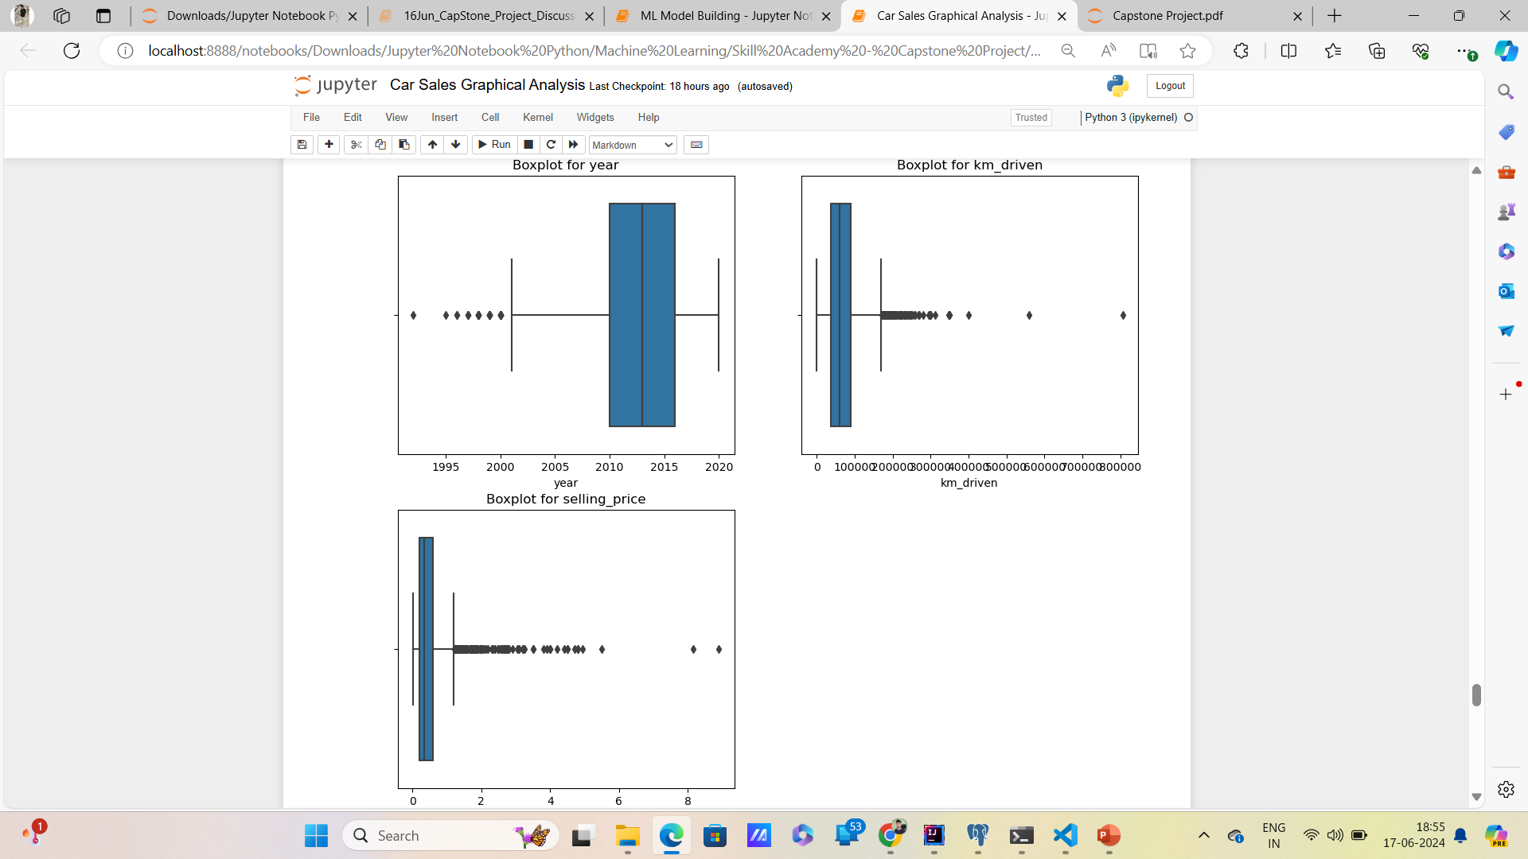
Data Exploration (Using Python)
Outliers Detected in Year, Kilometer driven and selling price column

Slide 27
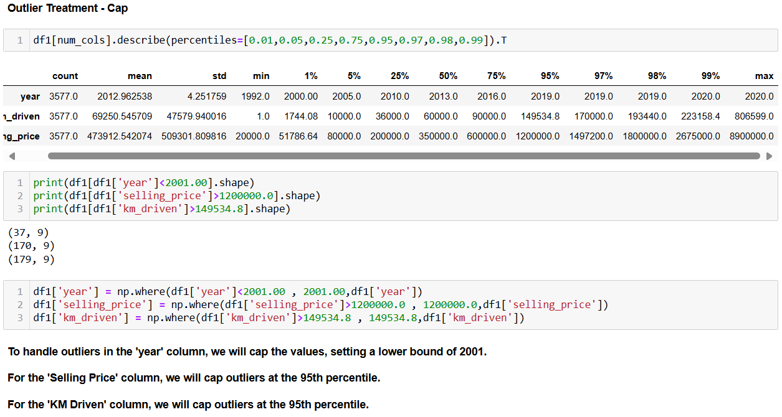
Data Exploration (Using Python)

Slide 28
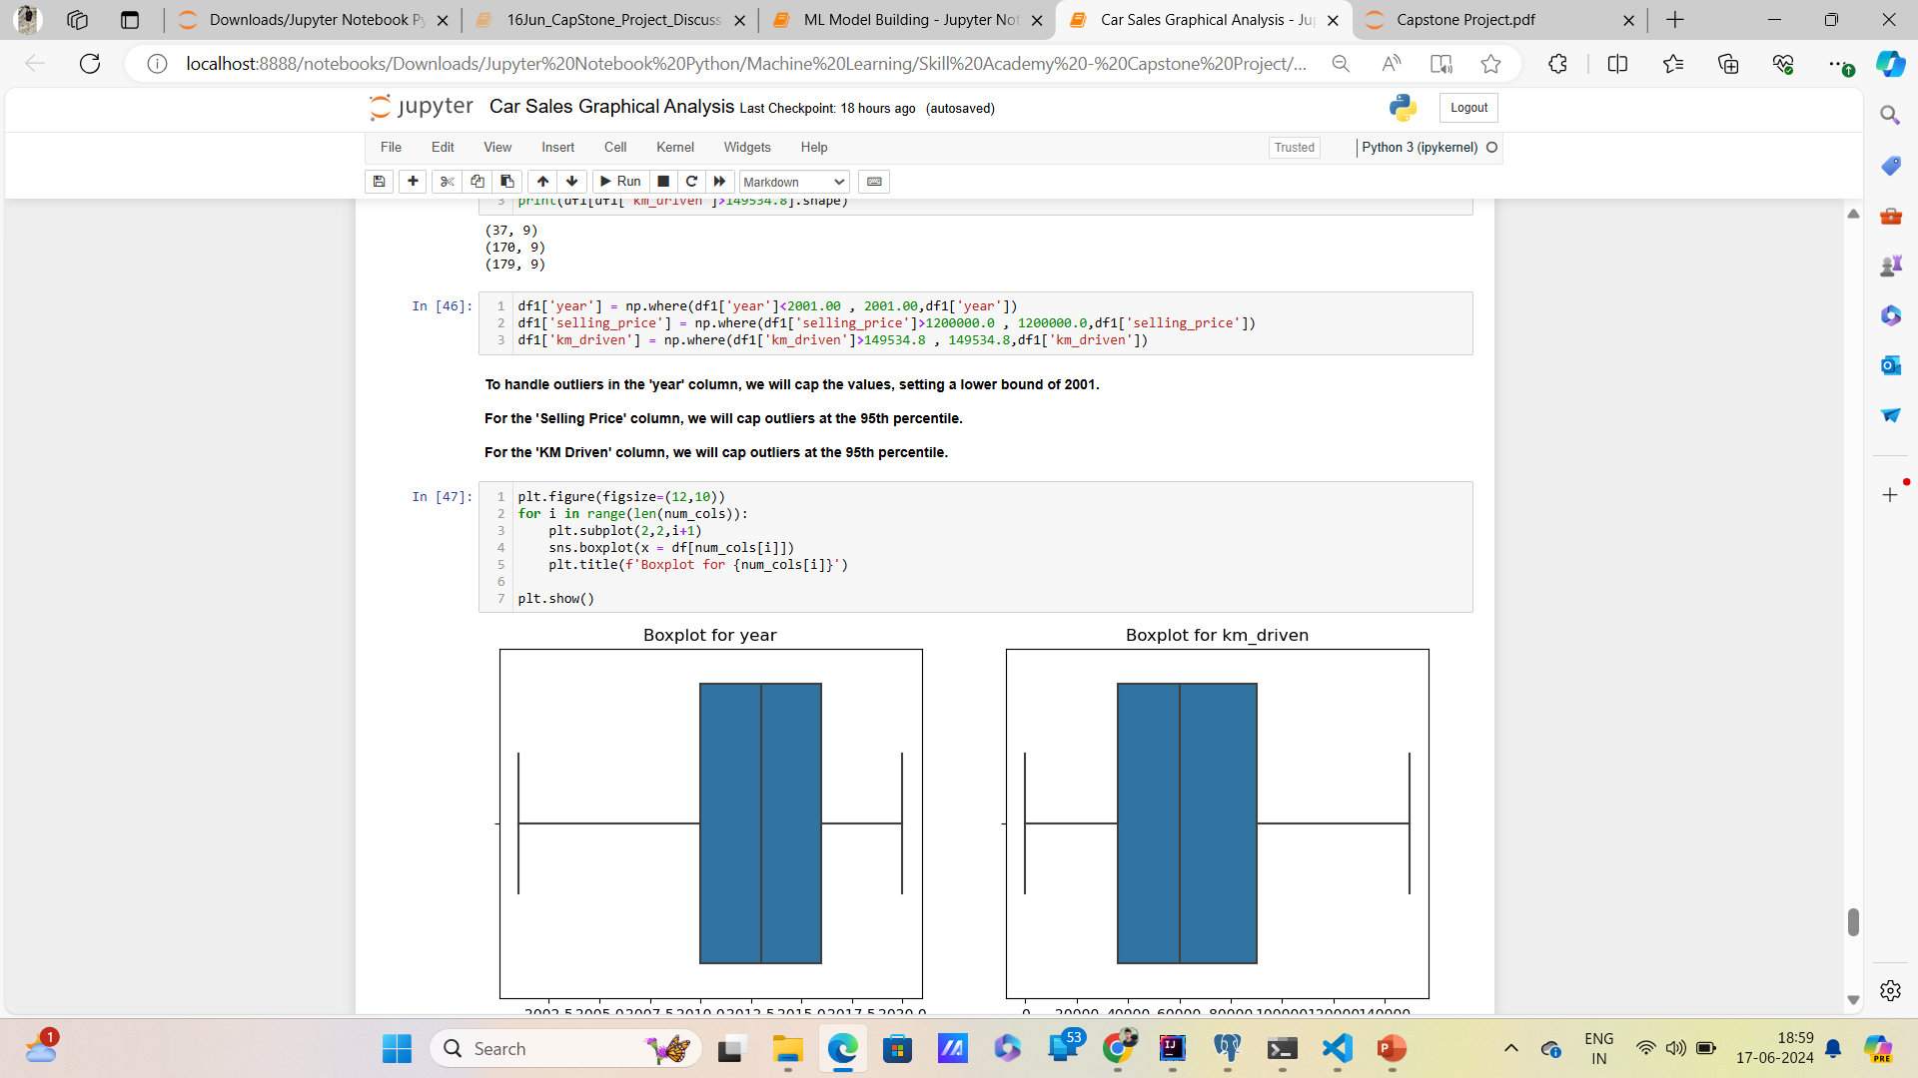
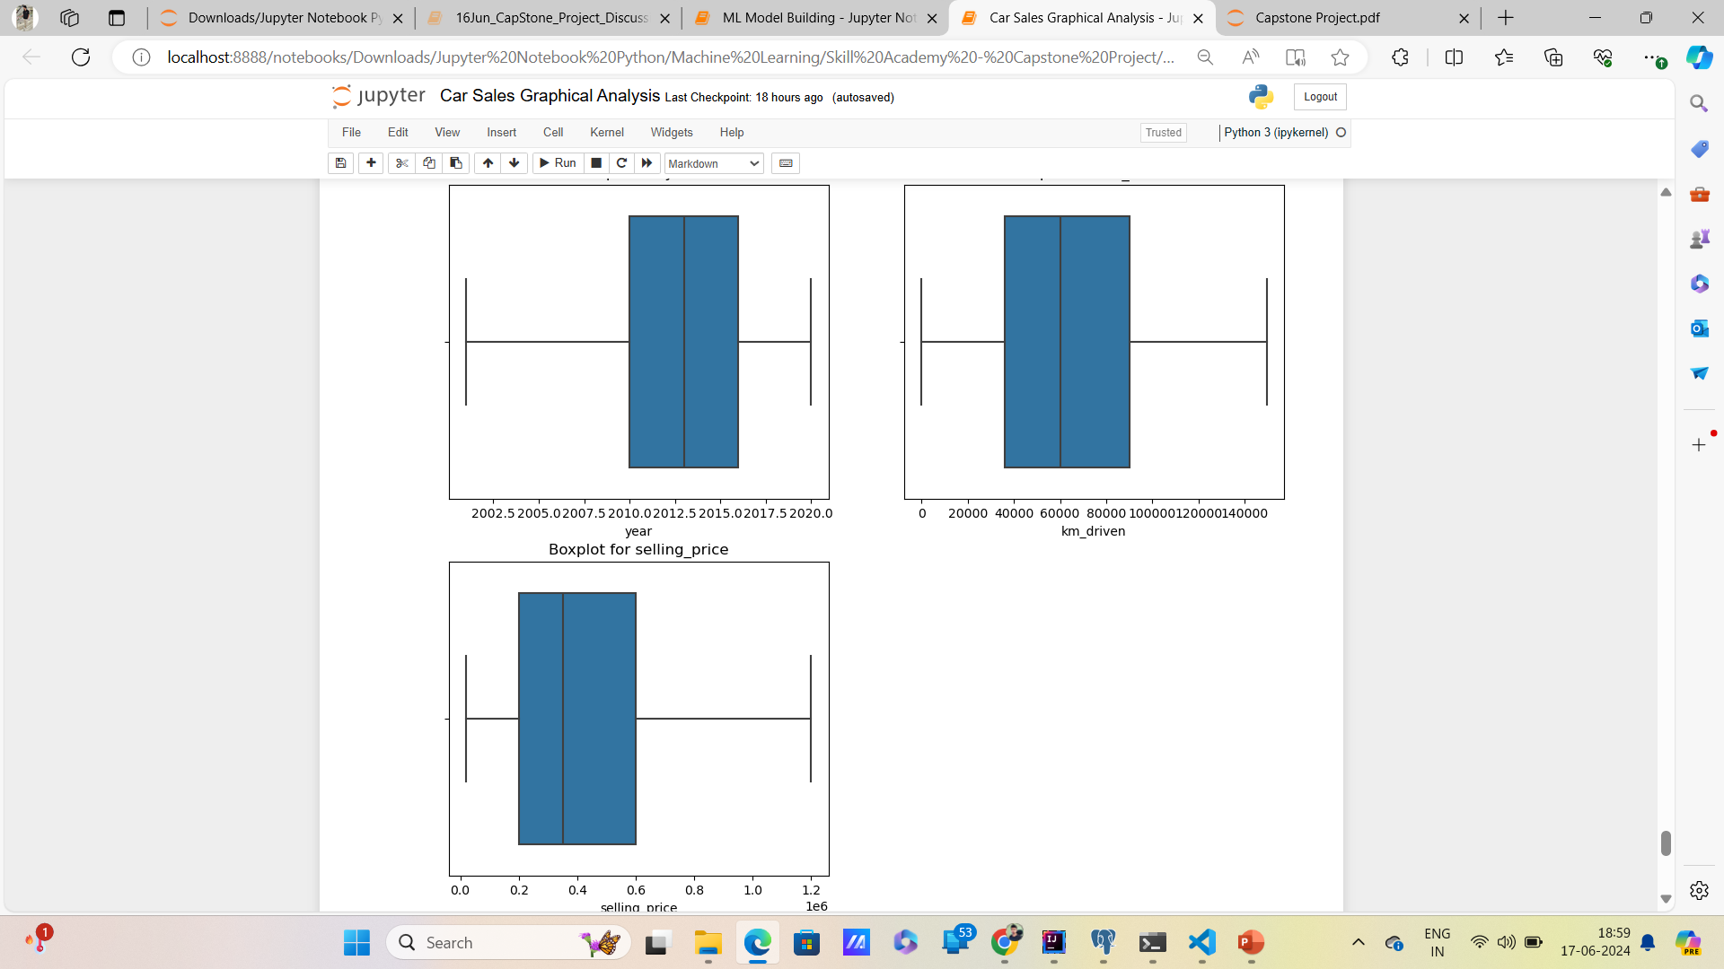
Data Exploration (Using Python)
BoxPlot after handling outliers.

Slide 29
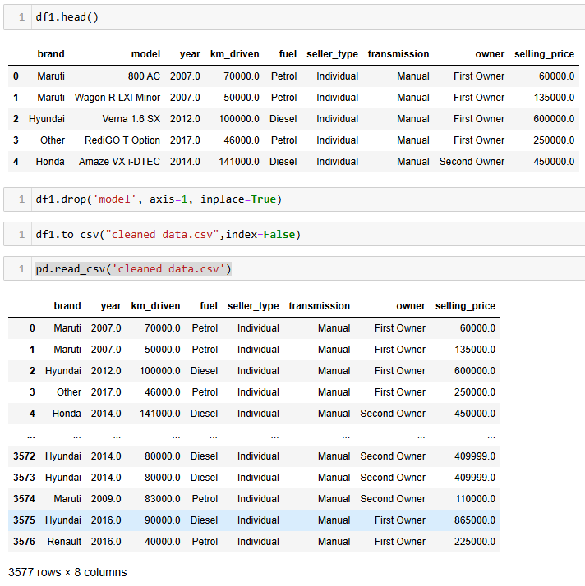
Data Exploration (Using Python)
Data Cleaning part is done and we saved our cleaned data. Now next we will move towards model building part.

Slide 30
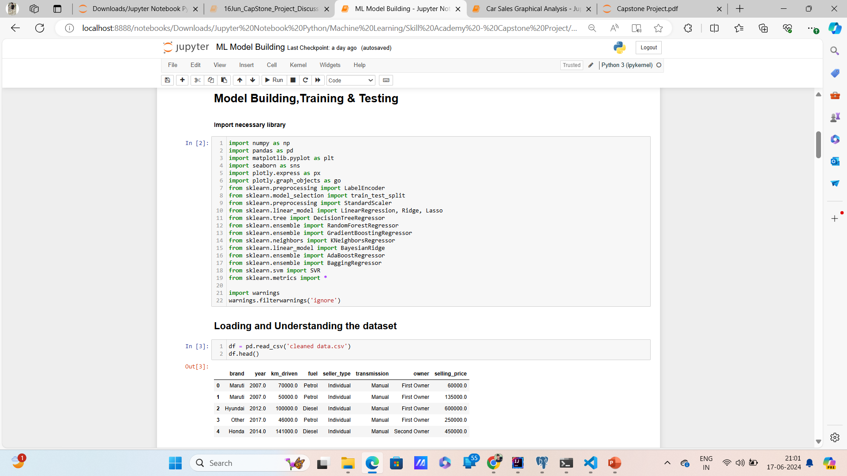
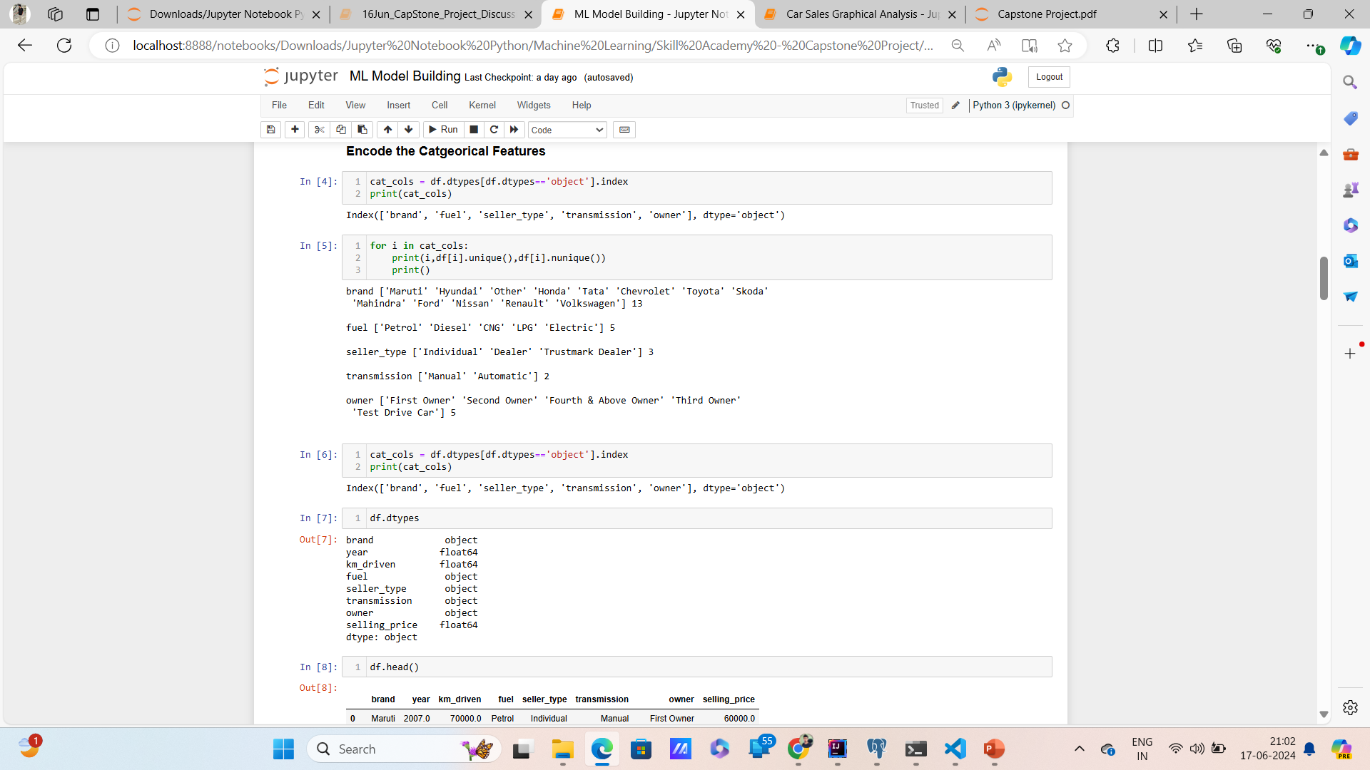
Machine Learning Model Buliding

Slide 31
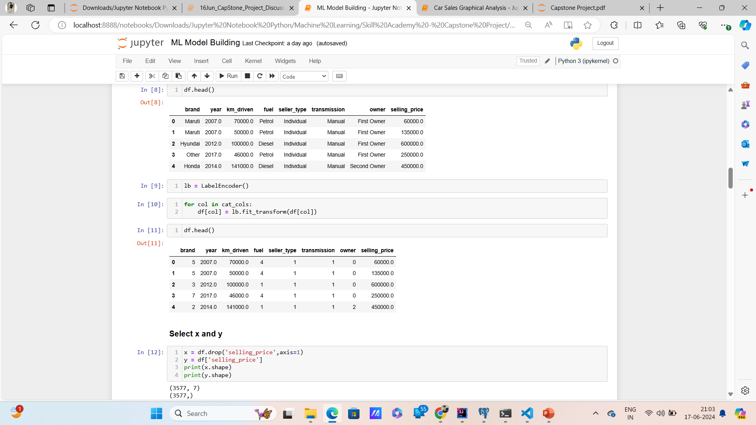
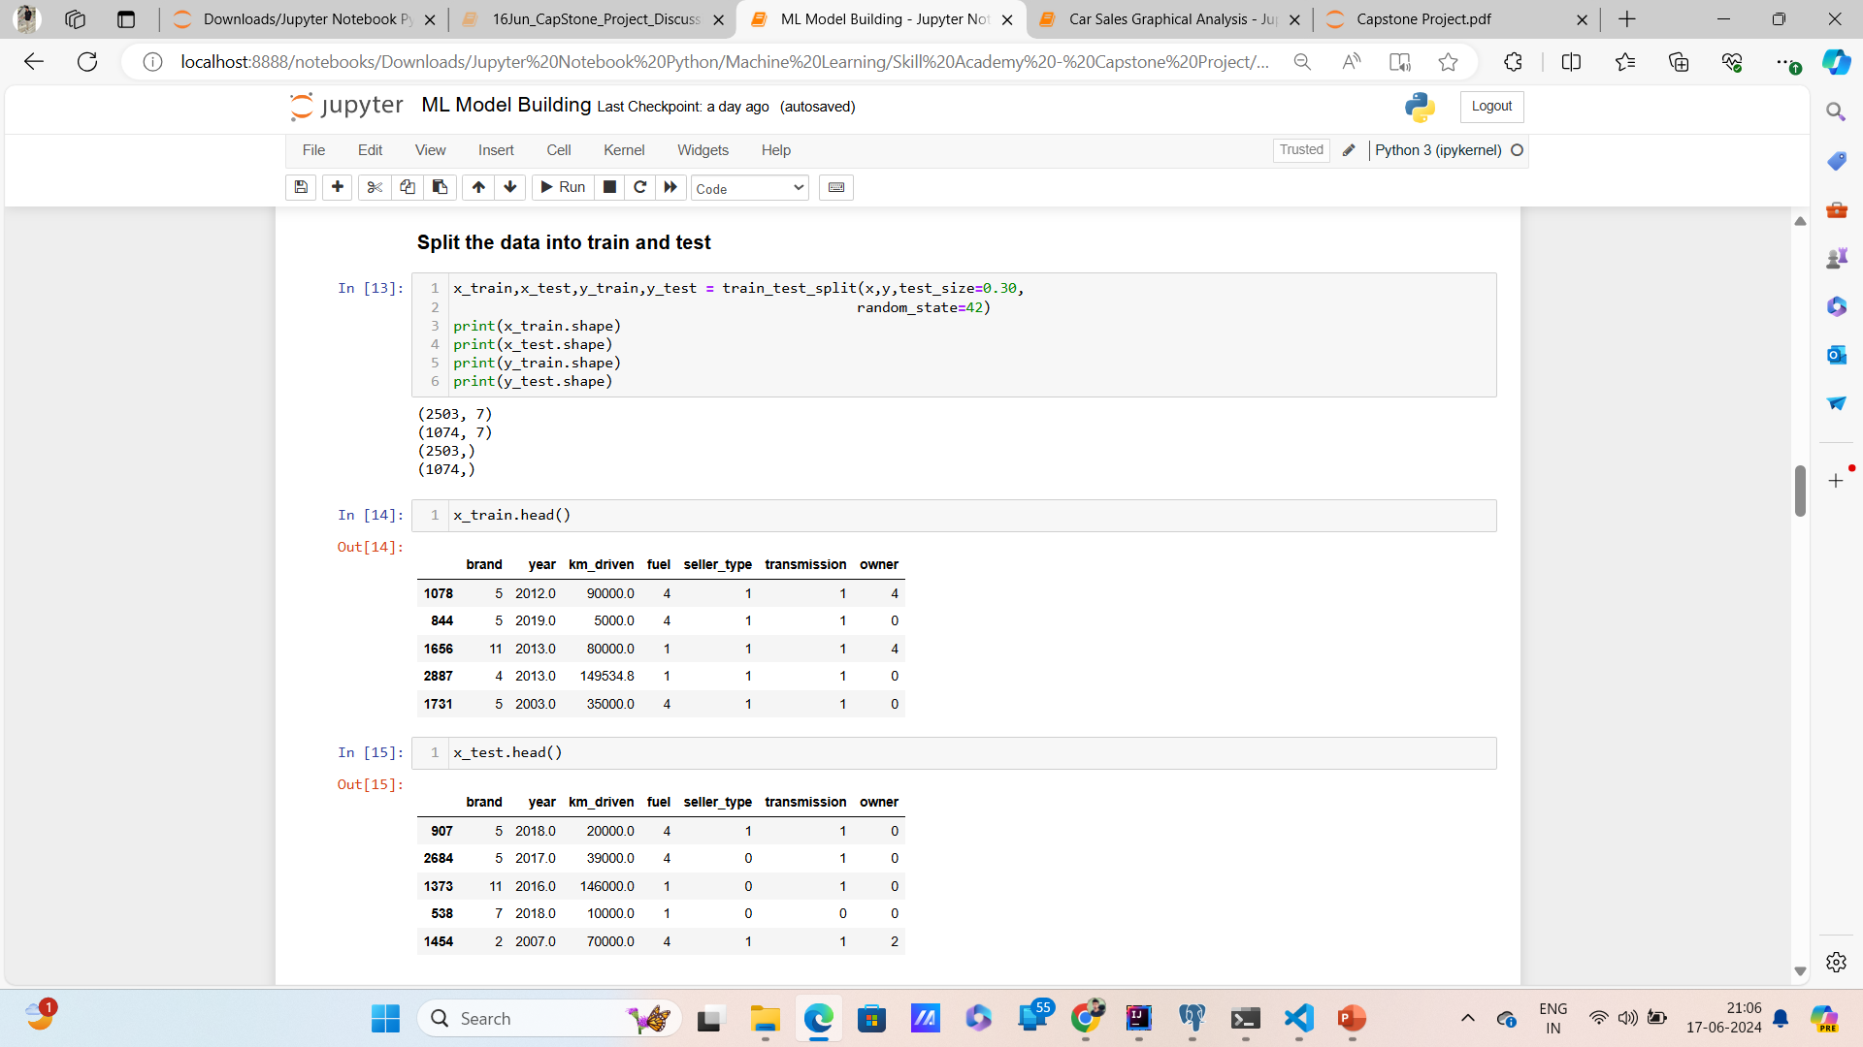
Machine Learning Model Buliding

Slide 32
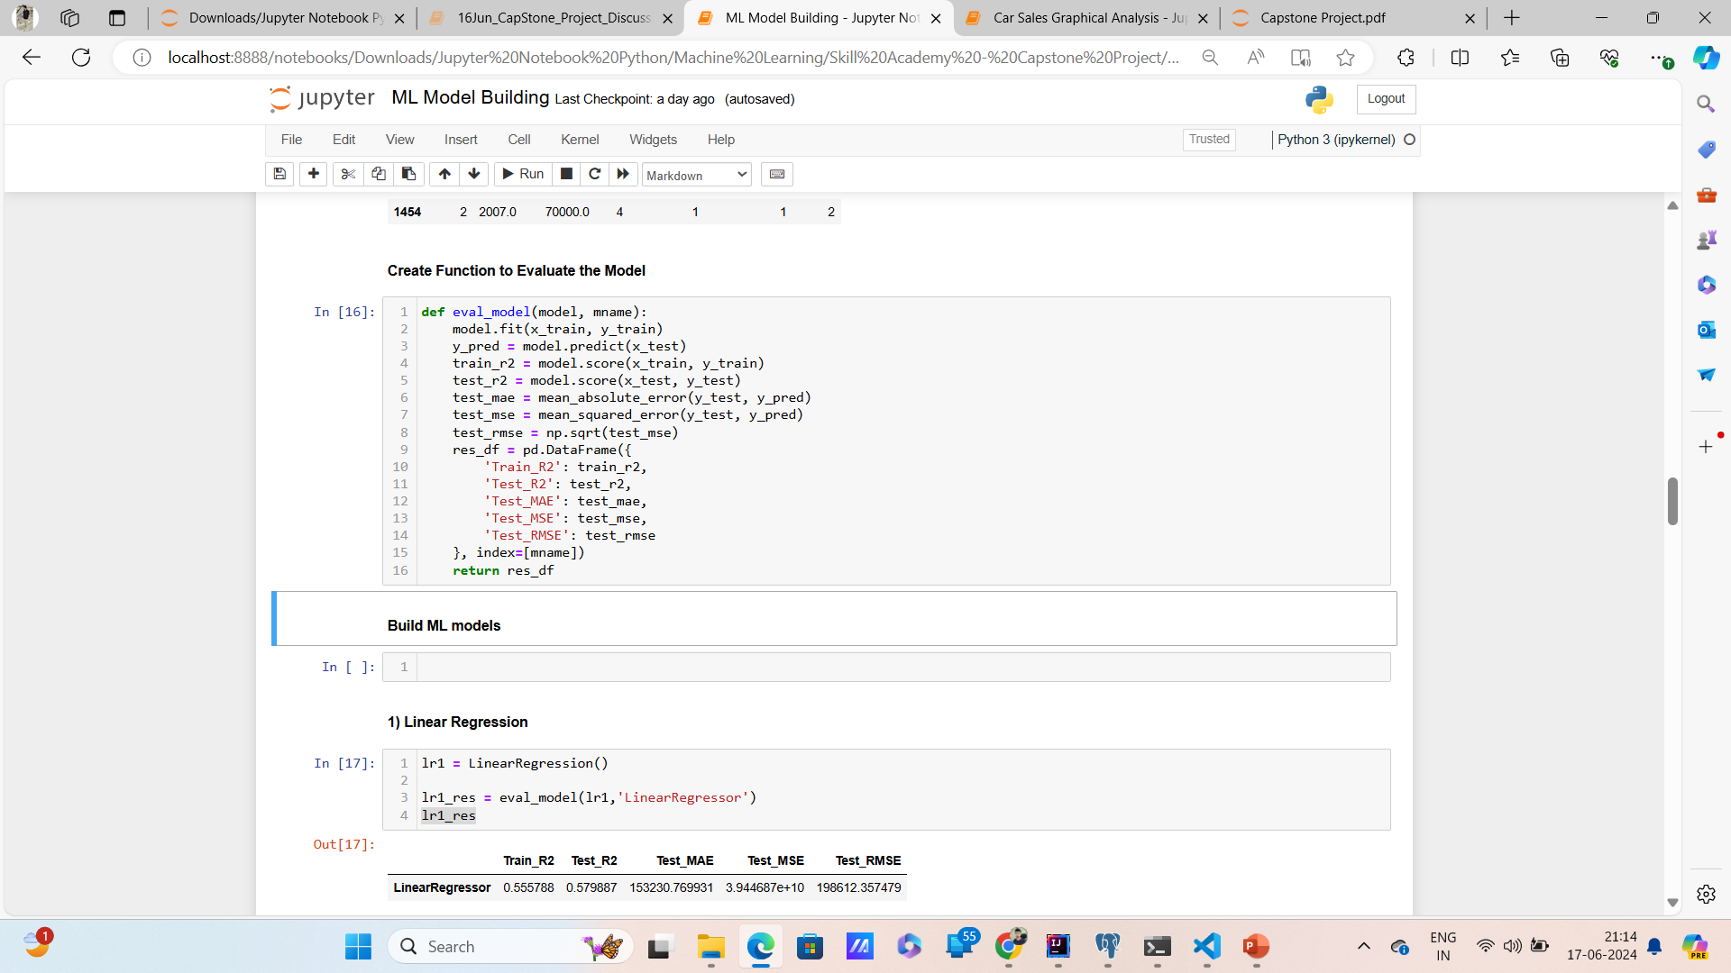
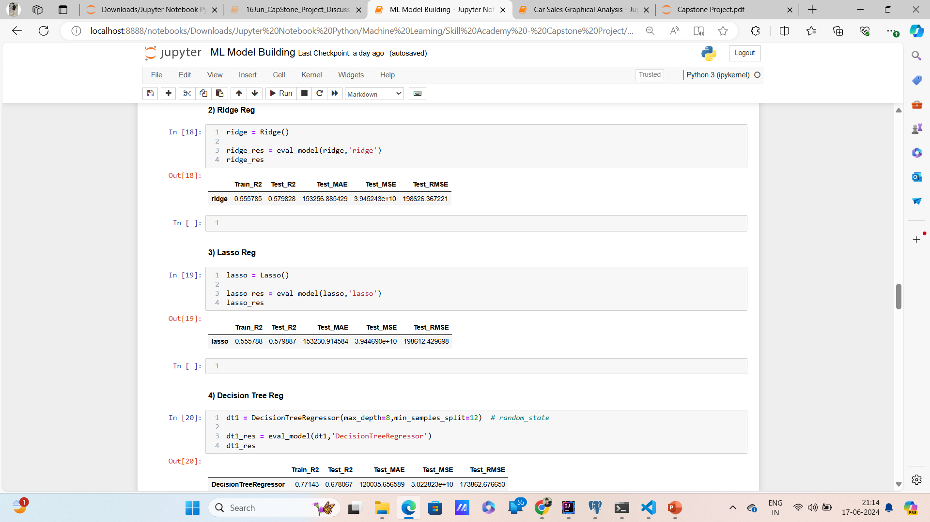
Machine Learning Model Buliding

Slide 33
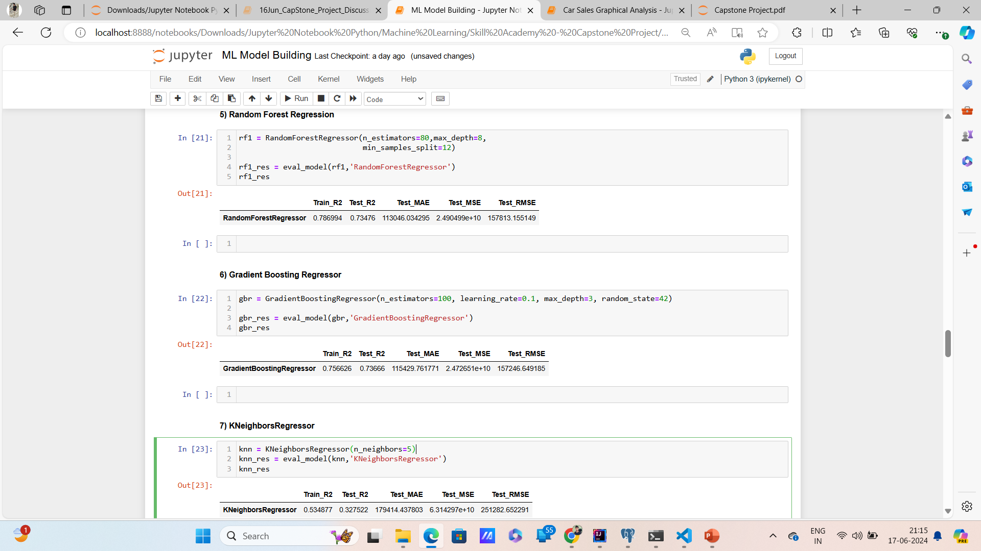
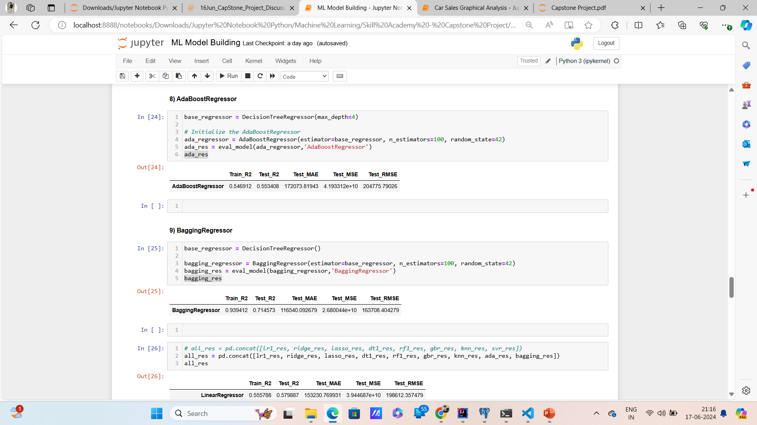
Machine Learning Model Buliding

Slide 34
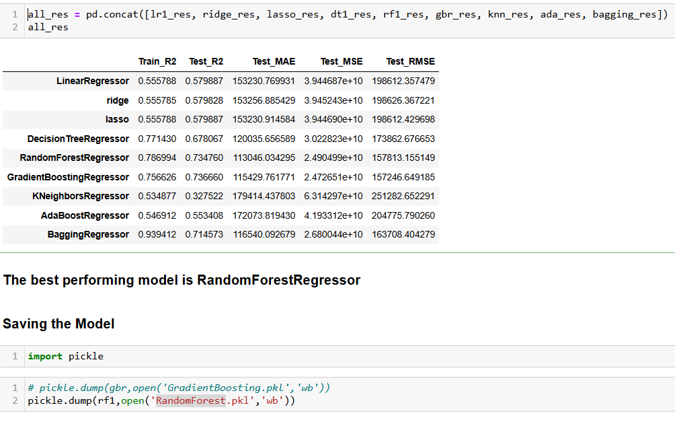
Machine Learning Model Buliding

Slide 35
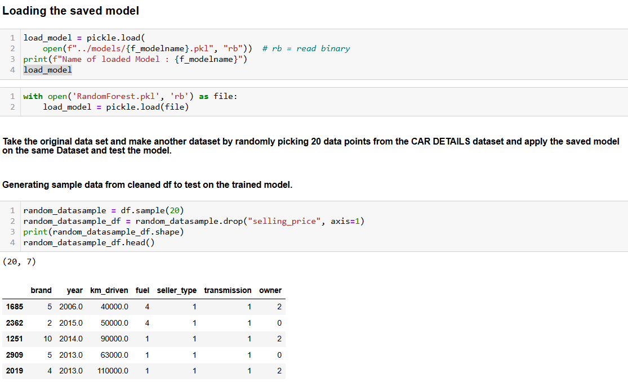
Machine Learning Model Buliding

Slide 36

Machine Learning Model Buliding

Slide 37


Machine Learning Model Buliding

Slide 38
Endnotes
About Me :
Name – Ravi Pandey
Course – Data Science With Python career Program (ChatGPT Included)
LinkedIn - Ravi Pandey
GitHub - Ravi
Email - ravipandey4568@gmail.com
Reference Links:-
GitHub Repo Link
Streamlit App Weblink

Slide 39

END

